Slide 1
Lessons from flipped classrooms: implementing partially and fully flipped classes across the mathematics curriculum
Olsume seminar – 11/3/2026
Dr. Rebecca swanson, university distinguished teaching professor, Colorado school of Mines

Slide 2
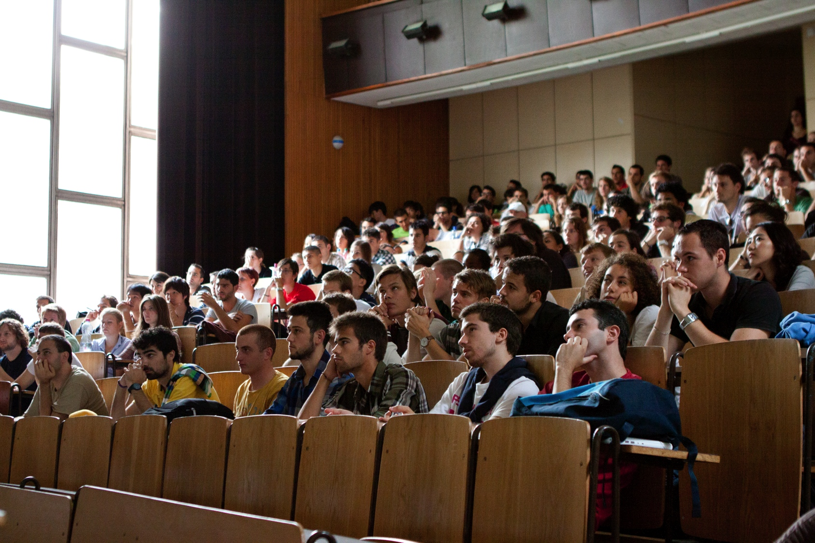
outline
Background/context
What?
Why?
How?
Other considerations

Slide 3

A bit about me & my work
Colorado School of Mines, a public engineering school with an undergraduate student population of about 7000
Types of positions:
  Assistant/Associate/Full Professor
  Assistant/Associate/Full Teaching Professor
  Teaching Postdoctoral Fellow
TF Duties: Teaching (18 credits), Service, Scholarship is optional
Scholarship = “Scholarship of Teaching and Learning”

Slide 4
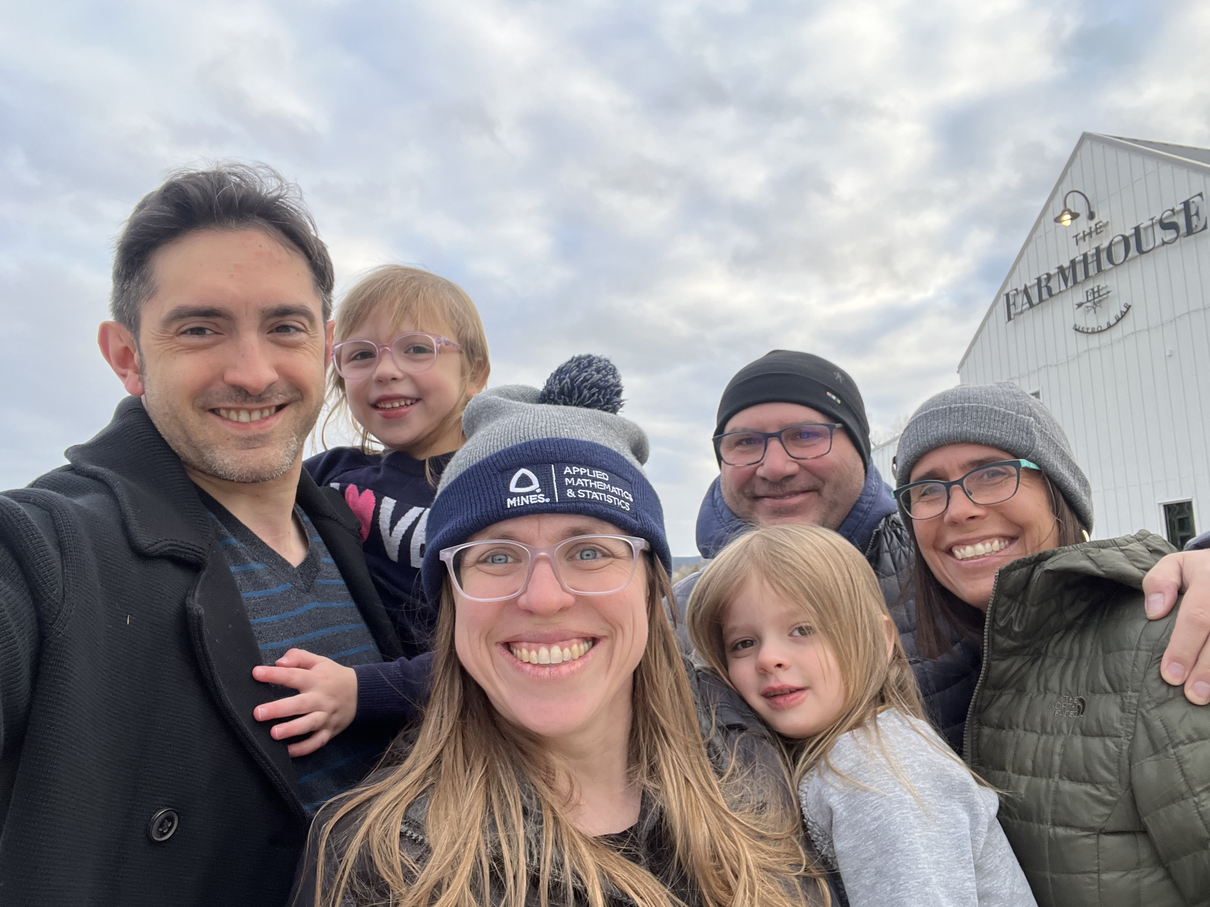
My path to flipped learning
After PhD from Indiana University, started at Colorado School of Mines in 2012
Attended Robert Talbert’s workshop on flipped learning at Cardiff University
Started working on Linear Algebra in 2014 with collaborators
First SoTL project was in flipped learning!

Slide 5

What is sotl? (Scholarship of teaching and learning)
The Scholarship of Teaching and Learning (SoTL) is the intellectual work that faculty members do when they use their disciplinary knowledge (in our case, mathematics) to investigate a question about their students’ learning (and their teaching), submit their findings to peer review, and make them public for others to build upon. - Curtis Bennett & Jacqueline Dewar

Slide 6
What sotl is NOT
Scholarly Teaching
  Scholarly teaching is defined as teaching grounded in critical reflection using systematically and strategically-gathered evidence, related and explained by well-reasoned theory and philosophical understanding, with the goal of maximizing learning through effective teaching.
Mathematics Education Research (or Discipline-Based Research)
  Mathematics education researchers obtain expertise in theories of learning that both guide their studies and help them interpret their results. They also study larger “structures,” help develop theories/frameworks, or work on other teaching-adjacent topics.

Slide 7
Classes I’ve flipped
Calculus II – 400+ students across 10+ sections of 40 per semester (coordinated)
Linear Algebra – 40 students per section per semester (not coordinated, but multi-section course)
Foundations of Advanced Mathematics – 30 students per semester (single-section course)
Topology - 35 students per semester (single-section course)
Notes:
Publications around results from both Calculus II and Linear Algebra

Slide 8
What is flipped learning?
Flipped learning is a pedagogical approach in which direct instruction moves from the group learning space to the individual learning space, and the resulting group space is transformed into a dynamic, interactive learning environment where the educator guides students as they apply concepts and engage creatively in the subject matter.
[Definition from Flipped Learning Network].

Slide 9
Flipped classrooms generally have two interconnected components
Pre-class direct instruction, where students learn at their own pace in an individual learning space
In-class active learning, where students engage in higher-order learning activities such as applying concepts and solving problems in a group learning space with instructor and peers
This doesn’t mean that there is no lecturing!

Slide 10
One more term
My collaborators and I use the term “PARTIALLY FLIPPED” to indicate that we were still spending about 40% of our class time lecturing!

Slide 11
comparison
Traditional classroom
Flipped classroom
In class: listening, telling, transcribing
After class: Application, Analysis, Assimilation
Before class: Students focus on lower-level tasks via videos, readings, tutorials, etc…
In-class: Analysis, application, assimilation with instructor guidance
After class: Some additional problem-solving/practice that students are (theoretically) better prepared for

Slide 12

Why?

Slide 13
Why?
You are with the students for the more challenging material
There’s time in class for active learning.
Preliminary activities can give you a peek into student thinking and misconceptions
More interaction with students

Slide 14
Why?
Evidence of learning gains from flipped classrooms
  In a metanalysis³ of 36 studies specific to flipped learning in mathematics, evidence of a small positive effect on academic performance (g=0.23), with larger effects on student satisfaction (g=0.53).
Evidence of learning gains from active learning
  In a metanalysis⁶ of 225 studies of active learning, student performance on exams and concept inventories increased by 0.47 standard deviations under active learning, and students in classes with traditional lecturing were 1.5 times more likely to fail than were students with active learning. Restricting to the 29 studies specific to math also gave a small positive effect on academic performance (g=0.32).
  Benefits are not always equal.^{11, 14}
Additional emerging evidence¹³ for a theoretical framework and what constitutes as “best practices.”
Notes:
Here, Hedges’ \(g\) expresses the difference between the flipped and lecture groups’ average outcomes in standard-deviation units. It also includes a correction for bias in small samples.
So:
\(g=0.20\): The flipped group’s average was 0.20 standard deviations higher.
\(g=0.53\): The flipped group’s average was 0.53 standard deviations higher.

Slide 15
Example – partially flipped Linear Algebra
Preliminary work:
  Videos recorded by Deb, Nic, or me
  Preliminary questions in our LMS
In class Part 1:
  Student Group work (builds on preliminary)
In class Part 2:
  Lecture: synthesize the preliminary/group work
Example: Linear Independence
Students watched an 8-minute video that provided the definition of linear independence and used Gaussian elimination to determine whether a set of vectors was linearly independent.
They answered a couple of basic questions about linear independence

Slide 16
Example – partially flipped Linear Algebra
Preliminary work:
  Videos recorded by Deb, Nic, or me
  Preliminary questions in our LMS
In class Part 1:
  Student Group work (builds on preliminary)
In class Part 2:
  Lecture: synthesize the preliminary/group work
Example: Linear Independence
Students worked in groups that had them examine sets of vectors to start looking for patterns and to build intuition about linear independence.

Slide 17
Example – partially flipped Linear Algebra
Preliminary work:
  Videos recorded by Deb, Nic, or me
  Preliminary questions in our LMS
In class Part 1:
  Student Group work (builds on preliminary)
In class Part 2:
  Lecture: synthesize the preliminary /group work
Example: Linear Independence
Lecture returns to the group work problems as intuition for a couple of theorems I go on to prove about linearly independent sets.

Slide 18
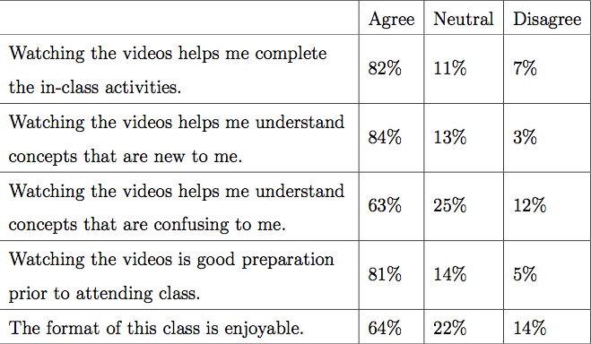
Example – partially flipped Linear Algebra
Our results⁴ (comparing to sections we taught traditionally that used the same final exam):
  Final exam averages went up 6.3 percentage points.
  DFW rates went down from an average of 18.6% to 11.3%.
  Students were generally happy (majority) or neutral regarding the course format.

Slide 19
Example – partially flipped Calculus II
Preliminary work
  Instructor-created video OR reading
  Preliminary questions
In-class Part 1: Hook + Mini-lecture
In-class Part 2: Student work on scaffolded problems
In-class Part 3: Wrap-up
Example: Work/Lifting problems
Reading about the W=Fd formula and what assumptions are made when using it
Preliminary questions that ask about those assumptions and compute a simple work problem

Slide 20
Example – partially flipped Calculus II
Preliminary work
  Instructor-created video OR reading
  Preliminary questions
In-class Part 1: Hook + Mini-lecture
In-class Part 2: Student work on scaffolded problems
In-class Part 3: Wrap-up
Example: Work/Lifting problems
Hook problem: What requires more work?
  Lifting 20 meter-long coiled rope up 20 meters
  Pulling a 20-meter rope hanging from a building to the top of the building
Discussion of how integrals become involved

Slide 21
Example – partially flipped Calculus II
Preliminary work
  Instructor-created video OR reading
  Preliminary questions
In-class Part 1: Hook + Mini-lecture
In-class Part 2: Student work on scaffolded problems
In-class Part 3: Wrap-up
Example: Work/Lifting problems
Students work in groups with a set of increasingly challenging problems
We don’t expect every group to get through them all!
End by wrapping up the big ideas from what they saw in those problems.

Slide 22
Student success: Percentage of Students Scoring at Least a 70% on Selected Final Exam Questions^{5, 15}
 |  | Not Flipped | Flipped -CS | Flipped-OTHER | Flipped | Overall
Enrollment |  | 172 | 103 | 151 | 254 | 426
Learning Outcomes
LO1: Computation | Q1 | 68.6 | 81.7 | 74.3 | 77.3 | 73.8
 | Q2 | 57.8 | 77.7 | 63 | 69 | 64.5
 | Q12 | 49.4 | 67.5 | 59.3 | 62.6 | 57.3
LO2: Application | Q3 | 87.3 | 95.6 | 97.2 | 96.7 | 92.9
 | Q11 | 53.6 | 67.3 | 59.8 | 62.8 | 59.1
 | Q14 | 79.5 | 86.9 | 82.8 | 84.4 | 82.5
LO3: Reasoning | Q6 | 74.7 | 77.5 | 71.9 | 74.2 | 74.4
 | Q7 | 56.5 | 60.4 | 64.3 | 62.7 | 60.2
 | Q8 | 64.8 | 82.7 | 77.4 | 79.6 | 73.6

Slide 23
Example – Foundations of Advanced Math (introductory proofs course)
Preliminary work:
  Reading OR videos created by a professor from a different institution
  Preliminary questions
In-class:
  Most of the time students are working
  Lecturing takes 10-15%
Examples: Format was slightly different depending upon the topic!
Logic unit (e.g. Truth tables)
Proof techniques (e.g Direct Proof)
Additional modules (e.g. Functions)

Slide 24
Example – Partially flipped Topology
Preliminary work:
  Reading portion of textbook
  Preliminary questions on LMS
In-class part 1: Student work in groups
In-class part 2: Lecture
Similar in structure to Linear Algebra!

Slide 25

Common questions/comments
How do you decide what goes where?
How do you create activities?
How do you get students to do the work and buy into this system?
This all sounds like too much work.

Slide 26
Guiding principle: Learning outcomes
Alignment between these tasks is what is most important!
The starting point is knowing what you want students to get out of a particular topic. What do you want them to know or be able to do?
Generally, move the “easier” or “lower level” stuff outside
Make more room for the “harder stuff” during class

Slide 27
Preliminary work
Videos or readings?
Something else?
Who creates the videos?
How long should a video be?
Considerations in assigning readings
Alternatives: interactive modules, problem-solving
Accountability?
Could be “quizzes” in LMS
Embedded quizzes in videos
Group work immediately in class

Slide 28
Preliminary work
LMS quizzes
  Number of attempts? When are they due?
  Be thoughtful about what types of problems you use.
  Conceptual vs. computational
  Think about “productive failure”
  I use “What questions do you have?” as the last question on these quizzes

Slide 29
Class time considerations
Class size and support
How much time should be spent on active learning vs. lecture?
  Recent work⁹ showed the biggest gains occurred when the in-class time included some lecture but didn’t specify how much!
  Other work¹⁴ shows there is significant effect in favor of starting with problem-solving before instruction (but this metanalysis didn’t limit to flipped classrooms)
If students are working in groups, how are those groups decided? What is expected of group members?

Slide 30
In-class Active learning options
Group work using scaffolded problems (the problems get more challenging as you go)
Clicker questions that allow students to think, pair, and share (can do this without clickers!)
Student presentations with questions/critiques
Other activities (e.g. matching, concept maps, jigsaws, peer review, etc…)

Slide 31
In-Class lecture
Could be many things:
  Chance to synthesize big ideas and the big picture
  Proving results
  Solving another problem that is more challenging or different in some way
  Responding to the feedback in the preliminary work
  Summarizing structure
  Review some of the problems from the group work
But don’t “re-teach” the preliminary work!

Slide 32
What do students do after class?
Often what they did before!
BUT… be thoughtful about student workload

Slide 33
Other considerations
Buy-in (trust)
Instructing students on how to effectively complete preliminary tasks
  Taking notes
  How to read math
Group work
  Group size and composition^{18, 19}
  Setting expectations for group work
  Who makes the groups? Do they change regularly?
  How is feedback given?

Slide 34
Other considerations
Day 1 Discussion:
Pick something that you learned how to do outside of academics (e.g. a musical instrument or a sport) and describe how you learned to do it?
Buy-in (trust)
Instructing students on how to effectively complete preliminary tasks
  Taking notes
  How to read math
Group work
  Group size and composition^{18, 19}
  Setting expectations for group work
  Who makes the groups? Do they change regularly?
  How is feedback given?
Robert Talbert’s SAFE list:
Simplify (“Students distrust complexity, because complexity communicates distrust in students.”)
Actually communicate
Follow through
Examine everything

Slide 35
Other considerations
Buy-in (trust)
Instructing students on how to effectively complete preliminary tasks
  Taking notes
  How to read math
Group work
  Group size and composition^{18, 19}
  Setting expectations for group work
  Who makes the groups? Do they change regularly?
  How is feedback given?
Be explicit with your students!
e.g. “You should take notes on the video and bring those to class with you so that you can refer to them during the group work.”
If asking students to read math, teach them how to read it.

Slide 36
Other considerations
Buy-in (trust)
Instructing students on how to effectively complete preliminary tasks
  Taking notes
  How to read math
Group work
  Group size and composition^{18, 19}
  Setting expectations for group work
  Who makes the groups? Do they change regularly?
  How is feedback given?

Slide 37

What about the faculty workload??
There is an initial start-up cost for any change we make in the classroom.
But once the stuff is created, you have it!
Ways to mitigate the workload aspect:
  Use other people’s materials.
  Work with others on planning the course and/or creating materials
  Don’t do it all at once! (e.g. Flipped Fridays or flip a particular unit)
  Think about ways to make giving feedback easier (e.g. for some group assignments, only one per group, etc…)

Slide 38
Closing thoughtS
Before class: What preparation will help students enter ready to participate?
During class: What thinking most benefits from peers, feedback, and my guidance?
Where do my students most need me? Sometimes they need a clear explanation. Sometimes they need feedback while they’re trying something difficult.
Thank you!!
Notes:
Flipped learning gives us an opportunity to design for those moments. The research gives us good reasons to try it.

Slide 39
References part 1
Bakla, A., & Mehdiyev, E. (2022). A qualitative study of teacher-created interactive videos versus YouTube videos in flipped learning. E-Learning and Digital Media, 19(5), 495–514. (DOI)
Bassett, K., Olbricht, G. R., & Shannon, K. B. (2020). Student preclass preparation by both reading the textbook and watching videos online improves exam performance in a partially flipped course. CBE—Life Sciences Education, 19(3), Article ar32. (DOI)
Bredow, C. A., Roehling, P. V., Knorp, A. J., & Sweet, A. M. (2021). To flip or not to flip? A meta-analysis of the efficacy of flipped learning in higher education. Review of Educational Research, 91(6), 878–918. (DOI)
Carney, D., Ormes, N., & Swanson, R. (2015). Partially flipped linear algebra: A team-based approach. PRIMUS, 25(8), 641–654. (DOI)
Carney, D., Sanders, M., Spiegel, S., Swanson, R., & Vasquez, A. (2021). Calculus II course redesign: Supporting faculty in pedagogical change. PRIMUS, 31(3–5), 643–657. (DOI)
Freeman, S., Eddy, S. L., McDonough, M., Smith, M. K., Okoroafor, N., Jordt, H., & Wenderoth, M. P. (2014). Active learning increases student performance in science, engineering, and mathematics. Proceedings of the National Academy of Sciences, (23), 8410–8415. (DOI)
Fyfield, M., Henderson, M., & Phillips, M. (2022). Improving instructional video design: A systematic review. Australasian Journal of Educational Technology, 38(3), 155–183. (DOI)
Johnson, E., Andrews-Larson, C., Keene, K., Melhuish, K., Keller, R., & Fortune, N. (2020). Inquiry and gender inequity in the undergraduate mathematics classroom. Journal for Research in Mathematics Education, 51(4), 504–516. (DOI)

Slide 40
References part II
Kapur, M., Hattie, J., Grossman, I., & Sinha, T. (2022). Fail, flip, fix, and feed—Rethinking flipped learning: A review of meta-analyses and a subsequent meta-analysis. Frontiers in Education, 7, Article 956416. (DOI)
Liu, L., Hew, K. F., & Du, J. (2024). Design principles for supporting self-regulated learning in flipped classrooms: A systematic review. International Journal of Educational Research, 124, Article 102319. (DOI)
Reinholz, D., Johnson, E., Andrews-Larson, C., Stone-Johnstone, A., Smith, J., Mullins, B., Fortune, N., Keene, K., & Shah, N. (2022). When active learning is inequitable: Women’s participation predicts gender inequities in mathematical performance. Journal for Research in Mathematics Education, 53(3), 204–226. (DOI)
Serbin, K. S., & Uhing, K. (2026). Using approximations of practice to support calculus instructors’ enactment of equitable active learning teaching practices. International Journal of Research in Undergraduate Mathematics Education. Advance online publication. (DOI)
Shen, Y., Spencer, D., Tagsold, J., & Kim, H. (2025). Integrating cognition, self-regulation, motivation, and metacognition: A framework of post-pandemic flipped classroom design. Educational Technology Research and Development, 73, 2425–2461. (DOI)
Sinha, T., & Kapur, M. (2021). When problem solving followed by instruction works: Evidence for productive failure. Review of Educational Research, 91(5), 761–798. (DOI)
Swanson, R., Carney, D., & Sanders, M. (2025). Adapting and sustaining change: A case study of a successful Calculus II course redesign during the pandemic years. PRIMUS, 35(4–5), 366–379. (DOI)
Theobald, E. J., et al. (2020). Active learning narrows achievement gaps for underrepresented students in undergraduate science, technology, engineering, and math. Proceedings of the National Academy of Sciences, 117(12), 6476–6483. (DOI)
Yu, Z., & Gao, M. (2022). Effects of video length on a flipped English classroom. SAGE Open, 12(1). (DOI)

Slide 41
References part III
Dasgupta, N., Scircle, M. M., & Hunsinger, M. (2015). Female peers in small work groups enhance women’s motivation, verbal participation, and career aspirations in engineering. Proceedings of the National Academy of Sciences, 112(16), 4988–4993. (DOI)
Grover, S. S., Ito, T. A., & Park, B. (2017). The effects of gender composition on women’s experience in math work groups. Journal of Personality and Social Psychology, 112(6), 877–900. (DOI)

