Slide 1
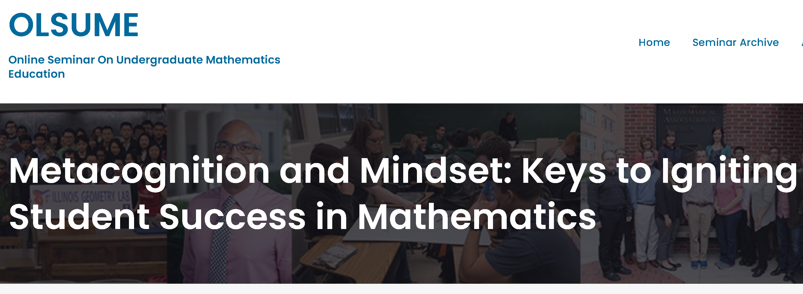
Saundra Yancy McGuire, Ph.D.
Professor Emerita, Department of Chemistry
Director Emerita, Center for Academic Success
Louisiana State University
smcgui1@lsu.edu

Slide 2
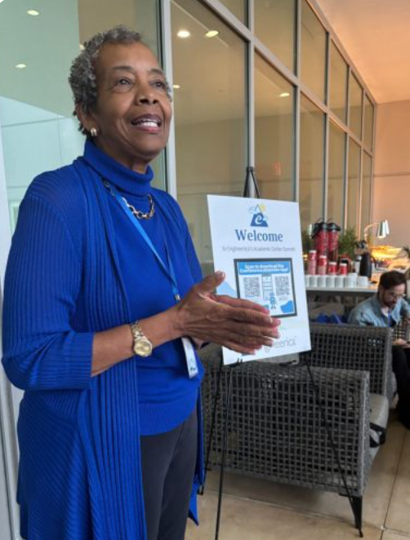
About Me
Started providing academic assistance to students in 1970 as a Chemistry Graduate Teaching Assistant at Cornell
M.A.T. Cornell University advised by Joseph Novak, 1971
Ph.D. University of Tennessee at Knoxville, 1983
Taught at Cornell, SUNY Brockport EOC, UT Knoxville, Alabama A&M, LSU
Started teaching students about metacognition at LSU in 2001, with colleagues in the Center for Academic Success
Elected Fellow of American Chemical Society (ACS), American Association for the Advancement of Science (AAAS), and the Council of Learning Assistance and Developmental Education Associations (CLADEA)
Named Among Top 100 Learning Influencers in History by Eduflow in 2023 (list includes Montessori and Piaget)
Author (with Dr. Stephanie McGuire) of Teach Students How to Learn and Teach Yourself How to Learn

Slide 3
Seminar Outcomes
At the seminar’s conclusion, attendees will be able to:
Define metacognition and give examples of how metacognitive learning strategies can improve learning in mathematics.
Explain why very capable students flounder in math and describe two paradigm shifting behaviors that can immediately and dramatically improve their performance
Create a plan for teaching metacognitive strategies in courses and/or interactions with students.

Slide 4
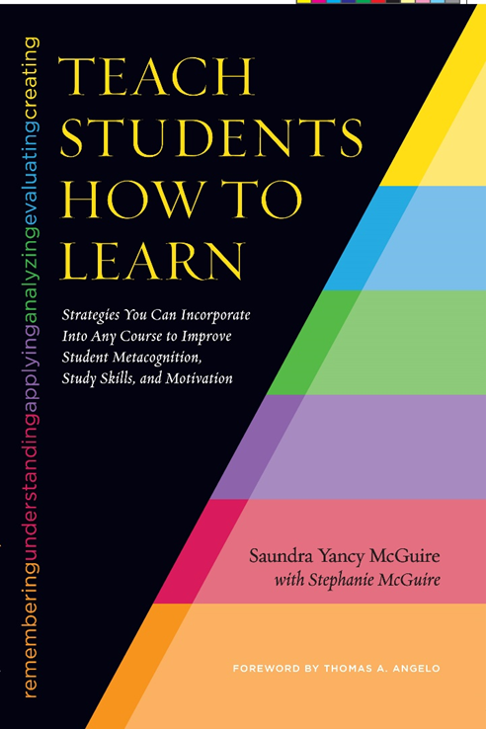

Resources for Today’s Seminar
Today is the trailer!
McGuire, S.Y. (2015). Teach Students How to Learn: Strategies You Can Incorporate into Any Course to Improve Student Metacognition, Study Skills, and Motivation. Sterling, VA: Stylus
McGuire, S.Y. (2018). Teach Yourself How to Learn: Strategies You Can Use to Ace Any Course at Any Level. Sterling, VA: Stylus

Slide 5

Metacognition
The ability to:
think about your own thinking
be consciously aware of yourself as a problem solver
plan, monitor, and control your mental processing (e.g. “Am I understanding this material, or just memorizing it?”)
accurately judge your level of learning
know what you know and what you don’t know
Flavell, J. H. (1976). Metacognitive aspects of problem solving. In L. B. Resnick (Ed.), The nature of intelligence (pp.231-236). Hillsdale, NJ: Erlbaum

Slide 6
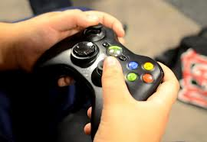


Why haven’t many students developed these skills?
It may not have been
necessary before now

Slide 7
How do you think most students would answer the following?
What did most of your teachers in high school do the day before the test?
What did they do during this activity?
What grade would you have made on the test if you had gone to class only on the day before the test?

Slide 8


Faculty Must Help Students Actively Engage in Learning
Help students identify and close “the gap”
current behavior
current learning
(and grades)
desired learning
(and grades)
productive behavior
The Phi Delta Kappan
Vol. 90, No. 2 (Oct., 2008), pp. 123-126
Published By: Phi Delta Kappa International
https://www.jstor.org/stable/20493571

Slide 9
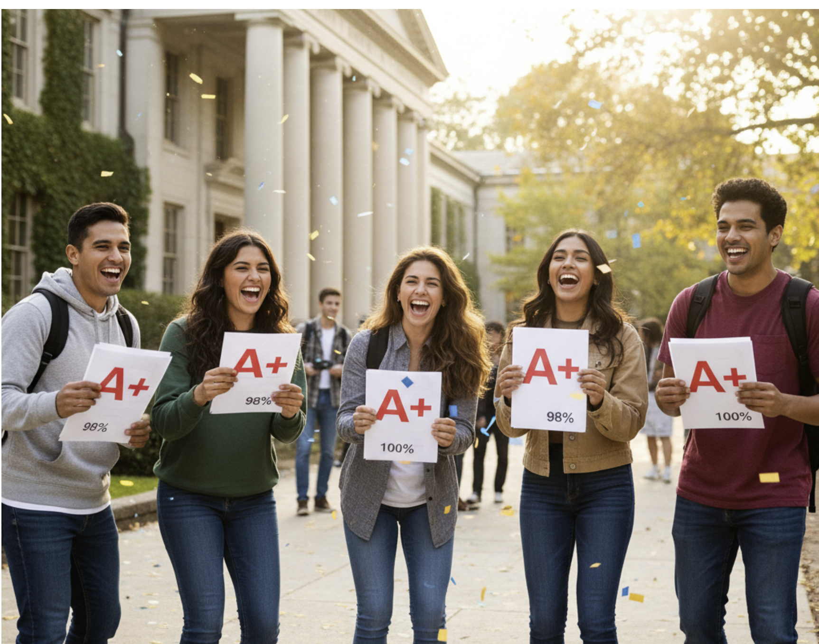
Impact of Attending a Center for Academic Success Workshop One Week Before Final Exam
Final Grades of 18 Summer Provisional Students in College Algebra Course at LSU
5 Students Attended workshop:
3A’s (60%); 5 B’s (40%); 0% C’s, D,s or F’s
DFW rate is 0%
13 students did not attend Workshop:
1 A (8%) 2 B’s (15% ) 4 C’s (31%) 3 D’s (23%)
3 F’s (23%)
DFW rate is 46%!

Slide 10
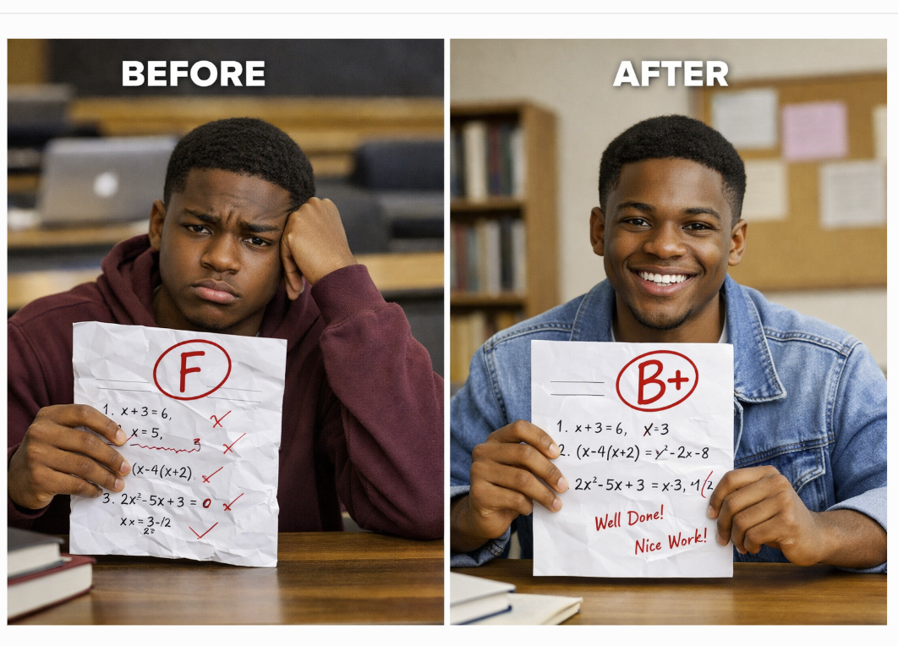
Before and After Learning Metacognitive Strategies: From Frustration to Confidence
Michael, senior pre-med organic student
30, 28, 80, 91 B in course
Miriam, freshman calculus student
37.5, 83, 93 B in course
Cathy, pre-freshman College Algebra student
77, 99.2
Robert, freshman chemistry student
42, 100, 100, 100 A in course
Meaningful Learning Rote Learning

Slide 11


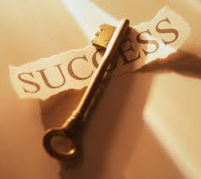
Why the Fast and Dramatic Increase?
It’s all about the strategies, and getting them to engage their brains!

Slide 12
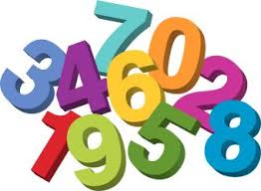
Finding Numbers in Sequential Order
How many can you find in
15 seconds?

Slide 13

Center for Academic Success

Slide 14

What were major differences between the first attempt and the second attempt?
We knew how the information was organized
We could look at a smaller section
We had seen it before

Slide 15
Reflection Questions Are Key to Helping Students Understand the Gap
What’s the difference between studying and learning?
For which task would you work harder?
A. Make an A on the test
B. Teach the material to the class
htpps://le.unimelb.edu.au/learning-teaching-assessment/assessment-and-feedback/reflective-practice

Slide 16
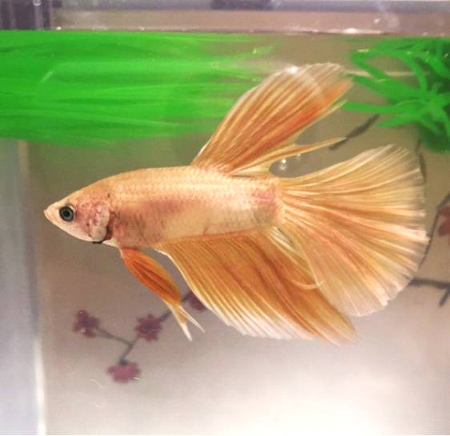
The Power of Teaching to Learn:
What Happened When Ty Taught His Betta Fish
First encounter on September 17, 2018
Email on October 25, 2018
Bio Exam Grades: 66, 98, 90 Final Grade B
Chem Exam Grades: 62, 83 Final Grade B

Slide 17
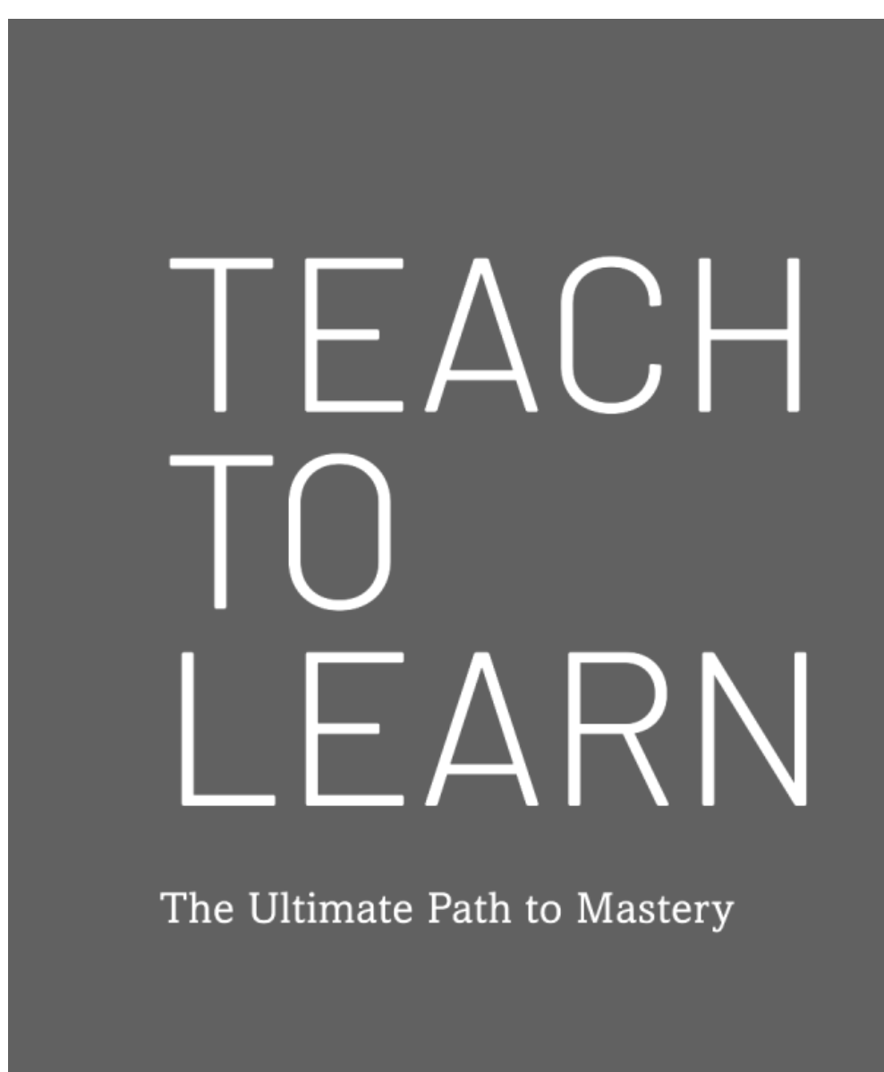
Impact of Teaching to Learn
Ty, LSU First Year Student
Email Received on October 26, 2018
I attended more of the Supplemental Instruction (SI) sessions and the exam reviews. Before the exam reviews and SI Sessions I would try to answer as many of the questions as possible to see about where I was in terms of grasping the information, then at the exam reviews/SI sessions I would know what I needed to understand.
Next after the reviews/SI sessions I would go to my room and “teach” the materials to my betta fish. The material I couldn’t explain, I would study more. I would continue that cycle until I could explain everything in my notes....

Slide 18
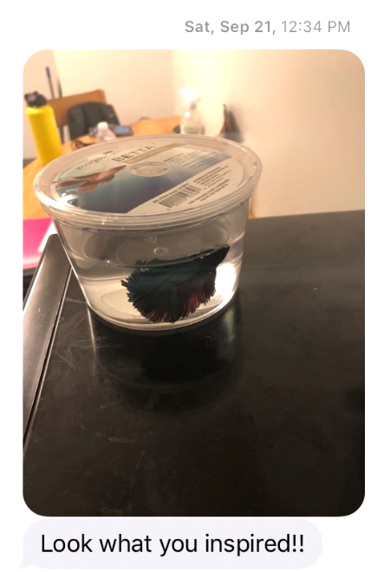
Betta fish purchased on September 21, 2019 by Howard University Honors Students
March 6, 2021 Update:
Sully was still alive and living with Makayla!
June 2022 Update:
Sully had gone to his Betta Fish home in the sky!
Karsh STEM Scholars recommitted to using strategies

Slide 19
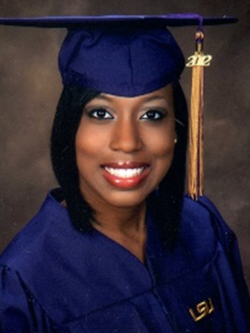
80, 54, 91, 97, 90 (final)
Dana, first year physics student
Interested in becoming a medical physicist since 10th grade after meeting the Imaging and Radiation Oncology Core (IROC) Group Director at MD Anderson Cancer Center
4.0 GPA in High School; Salutatorian of Graduating Class
Problem: Memorizing formulas and using Cramster (now Chegg) for homework help
Solution: Solve problems with no external aids and test mastery of concepts

Slide 20
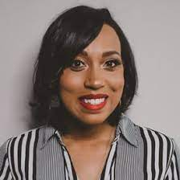

Dana Lewis, MS in Medical Physics, 2015
UT Graduate School of Biomedical Sciences at Houston
Thesis Advisor: Dr. Stephen Kry
Practicing Medical Physicist as of 8/28/2016
Current Position: Clinical coordinator, Fort Worth region, for the Texas Oncology residency program.

Slide 21

Effective Homework Strategy
Study material first, before looking at the problems/questions
Work example problems (without looking at the solutions) until you get to the answer
Check to see if answer is correct
If answer is not correct, figure out where mistake
was made, without consulting solution
Work homework problems/answer questions as if
taking a test

Slide 22



What we know about learning
Active learning is more lasting than passive learning
-- Passive learning is an oxymoron*
Thinking about thinking is important
--Metacognition**
The level at which learning occurs is important
--Bloom’s Taxonomy***
  *Cross, Patricia, “Opening Windows on Learning” League for Innovation in the Community College, June 1998, p. 21.
** Flavell, John, “Metacognition and cognitive monitoring: A new area of cognitive–developmental inquiry.” American Psychologist, Vol 34(10), Oct 1979, 906-911.
*** Bloom Benjamin. S. (1956). Taxonomy of Educational Objectives, Handbook I: The Cognitive Domain. New York: David McKay Co Inc.

Slide 23
Bloom’s Taxonomy
A Key Metacognitive Tool
Putting elements together to form a coherent or functional whole; reorganizing elements into a new pattern or structure through generating,
planning, or producing.
Creating
Making judgments based on criteria and standards through checking and critiquing.
Evaluating
Breaking material into constituent parts, determining how the parts relate to one another and to an overall structure .
Analyzing
Carrying out or using a procedure through executing, or implementing.
Applying
Constructing meaning from oral, written, and graphic messages through interpreting, exemplifying, classifying, summarizing, inferring, comparing, and explaining.
Understanding
Retrieving, recognizing, and recalling relevant knowledge from
long-term memory.
Remembering
http://www.odu.edu/educ/llschult/blooms_taxonomy.htm

Slide 24

When we teach students about Bloom’s Taxonomy…
They GET it!

Slide 25
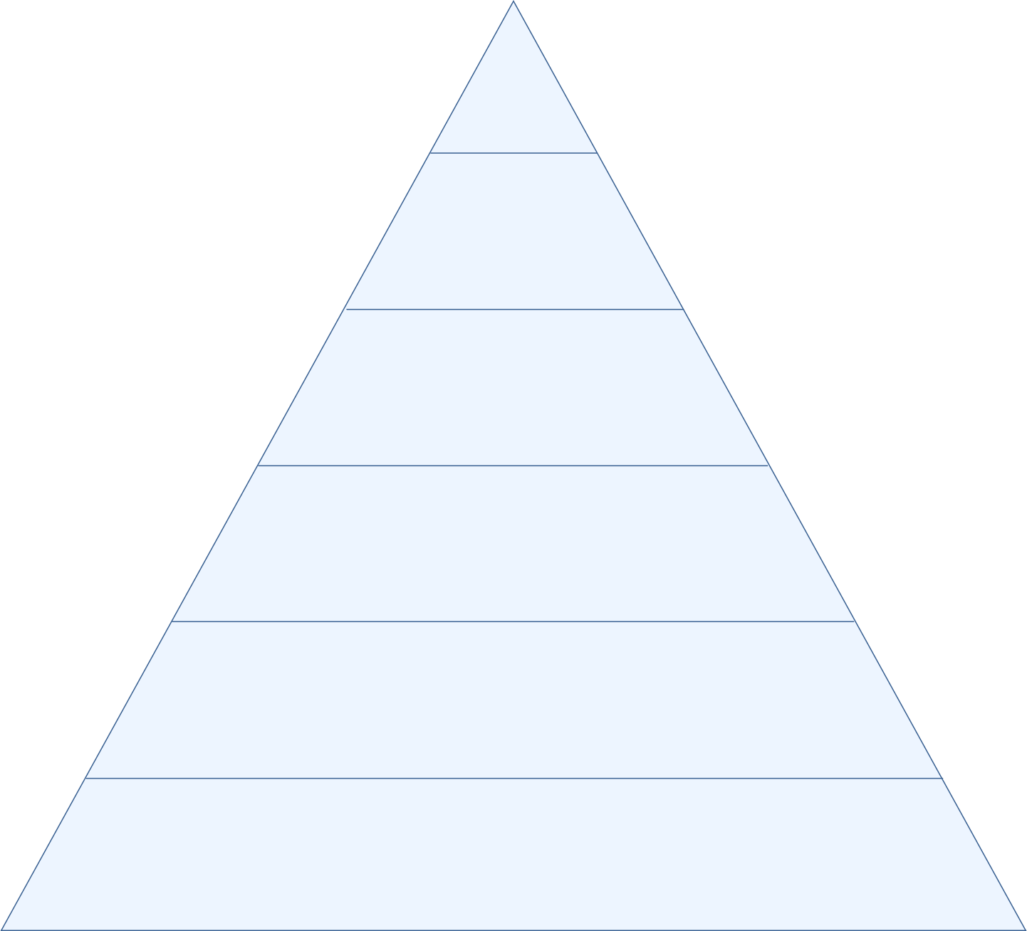
At what level of Bloom’s did you have to operate to make A’s or B’s in high school?
How do you think students answered?
Creating
Evaluating
Analyzing
Applying
Understanding
Remembering

Slide 26
At what level of Bloom’s do you think you’ll need to operate to make A’s in university math courses?
How do you think students answered?
Creating
Evaluating
Analyzing
Applying
Understanding
Remembering

Slide 27
At what level of Bloom’s will you need to operate to be an outstanding clinical laboratory scientist?
How do you think students would answer?
Creating
Evaluating
Analyzing
Applying
Understanding
Remembering

Slide 28
How do we teach students to move higher on Bloom’s Taxonomy?
Teach them the Study Cycle*
*adapted from Frank Christ’s PLRS system

Slide 30
Sharing Bloom’s and The Study Cycle Improved Learning
Dr. Kelter:
After the ND-Gateway workshop this August, I shared Dr. McGuire’s presentation with several of my colleagues and students in the ABEN department.
One ABEN student was struggling in his classes. I asked how he studied, and found he didn’t have good study habits. I shared the PPT with him on August 21, 2018, and also emphasized the content in slide 32 (Bloom’s Taxonomy) and slide 45 (Study Cycle). He wrote me an email today (September 7, 2018) and said:
“I actually am applying myself and changed my study and planning habits and it seems to be paying off already. I scored 114% on the first and only graded homework assignment so far and took the first exam on Wednesday and got 100%.”
I also applied the suggestion in Slide 14 to my class, and invited students to co-teach some lectures with me. They did a fantastic job by adding much more content and real world experience to the class. This is truly a wonderful experience for me because I saw that students poured their passion and talent into the lecture.
Please extend my appreciation to Dr. McGuire.
Thanks,
Xinhua Jia, Ph.D., P.E. Associate Professor, Agricultural and Biosystems Engineering
North Dakota State University

Slide 31
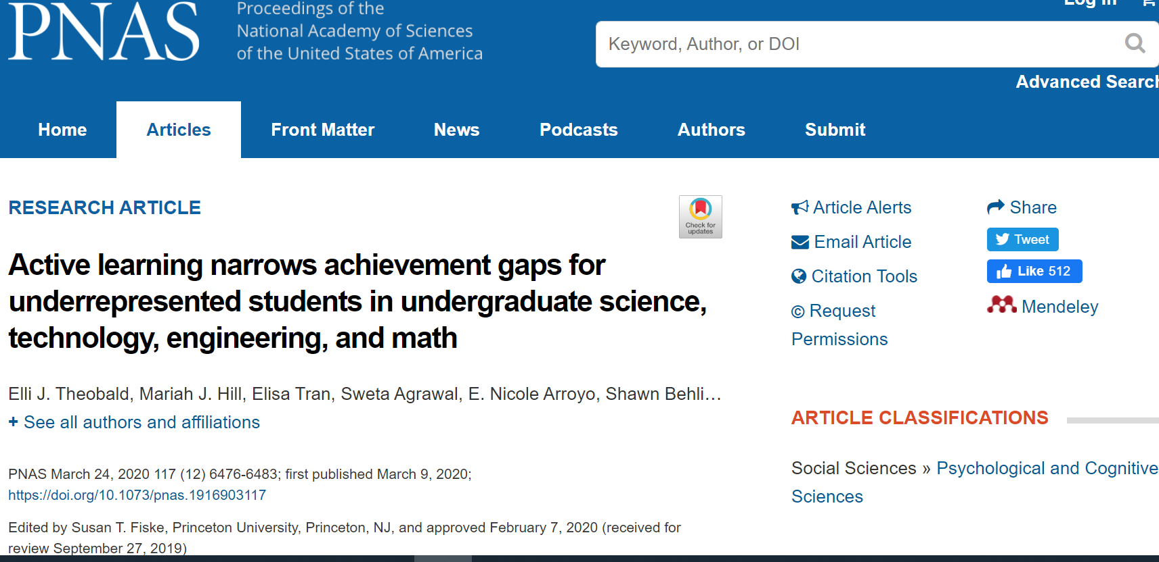

Slide 32
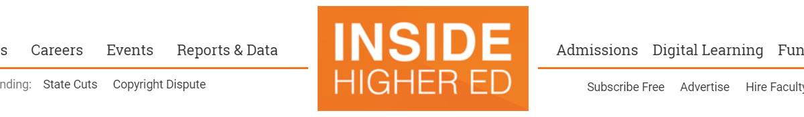
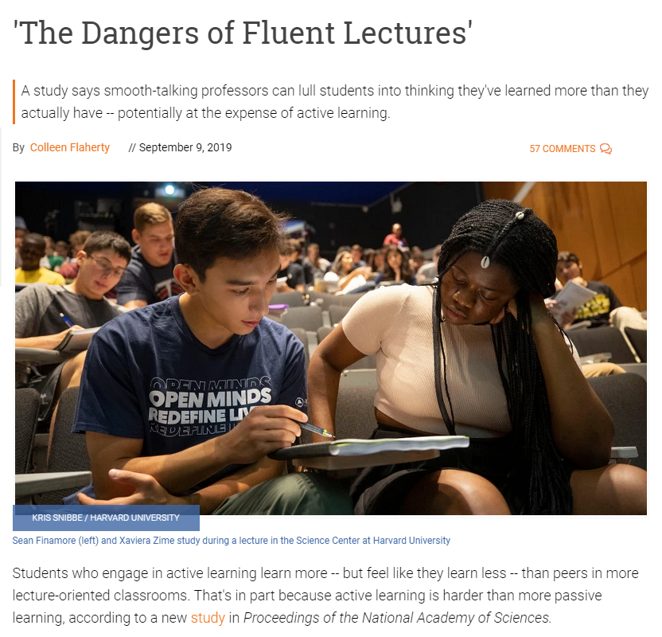
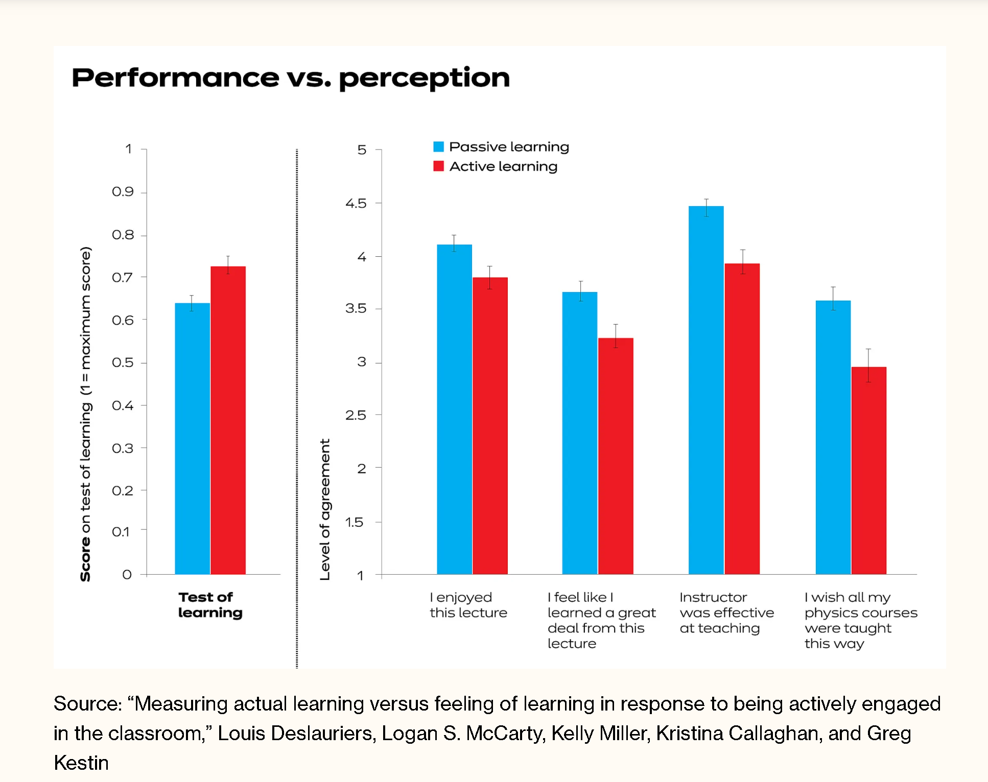
How Do Students Feel About Active Learning?
How Can We Change Their Minds?
Show Them The Evidence!
https://news.harvard.edu/gazette/story/2019/09/study-shows-that-students-learn-more-when-taking-part-in-classrooms-that-employ-active-learning-strategies/

Slide 33
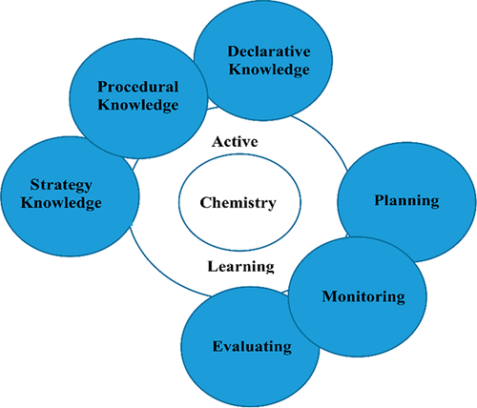
Metacognition and Active Learning Combination Reveals Better Performance on Cognitively Demanding General Chemistry Concepts than Active Learning Alone
Jacinta M. Mutambuki*, Mwarumba Mwavita, Caroline Z. Muteti, Brooke I. Jacob, and Smita Mohanty
Metacognition Enhances Efficacy of Active Learning
J. Chem. Educ. 2020, 97, 7, 1832–1840, Publication Date: June 25, 2020 https://doi.org/10.1021/acs.jchemed.0c00254

Slide 34

Results from Univ of Rhode Island Ace Your Course Challenge
979 students in eight sections of STEM gateway courses (3 disciplines; 6 courses)
Ordinary Least Squares Regression (OLS) performed to generate a statistically significant model (p<0.001)
Controlling for exam 1 score and high school GPA, we estimate that attending Dr. McGuire's workshop was associated with final grades that were 3.22 points higher (100 pt scale). Completing the challenge was associated with a final grade 5.61 points higher.
Final course grades:
Course only: C+
Attended metacognition workshop session: B
Attended workshop and completed AYC Challenge: B+
https://onlinelibrary.wiley.com/doi/epdf/10.1002/ntlf.30186
Notes:
2:10

Slide 35
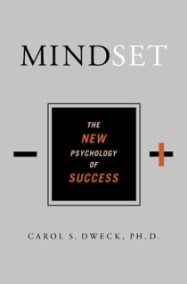

Mindset Matters
Dweck, Carol, 2006.
Mindset: The New Psychology
of Success. New York:
Random House Publishing
Shenk, David, 2010. The Genius in All of Us: Why Everything You've Been Told About Genetics, Talent, and IQ Is Wrong. New York: Doubleday

Slide 36
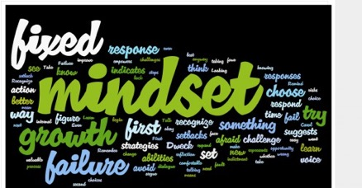
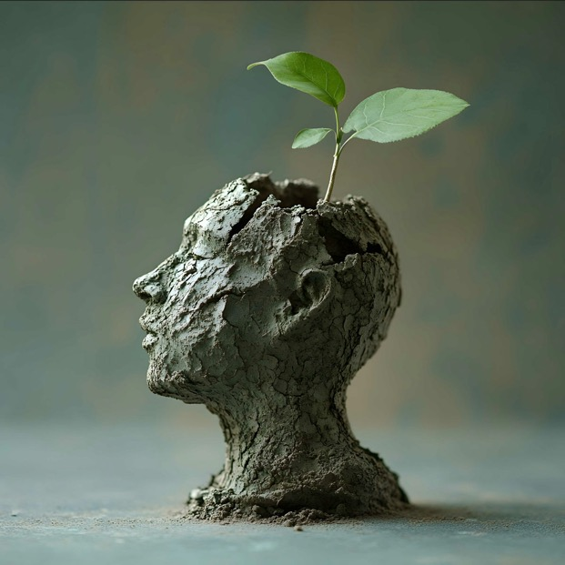
Fixed Intelligence Mindset
Intelligence is static
You have a certain amount of it
Growth Intelligence Mindset
Intelligence can be developed
You can grow it with actions
Dweck, Carol (2006) Mindset: The New Psychology of Success. New York: Random House Publishing

Slide 37
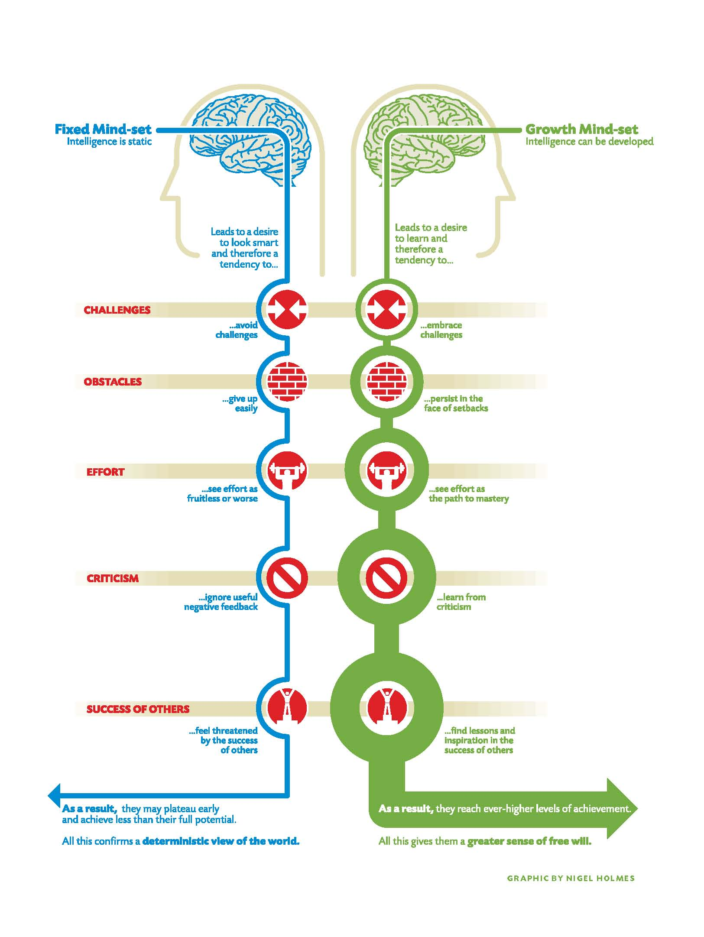

Slide 38
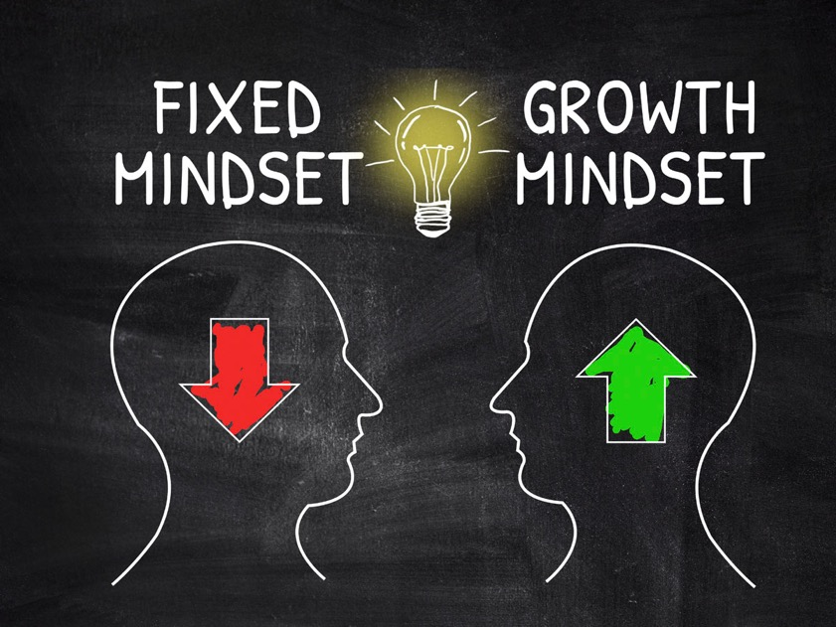
Which mindset about intelligence do you think most students have?
Fixed
Growth

Slide 39
Which mindset about student intelligence do you think most faculty have?
Fixed
Growth

Slide 40
Which mindset about student intelligence do you think most mathematics professors have?
Fixed
Growth

Slide 41
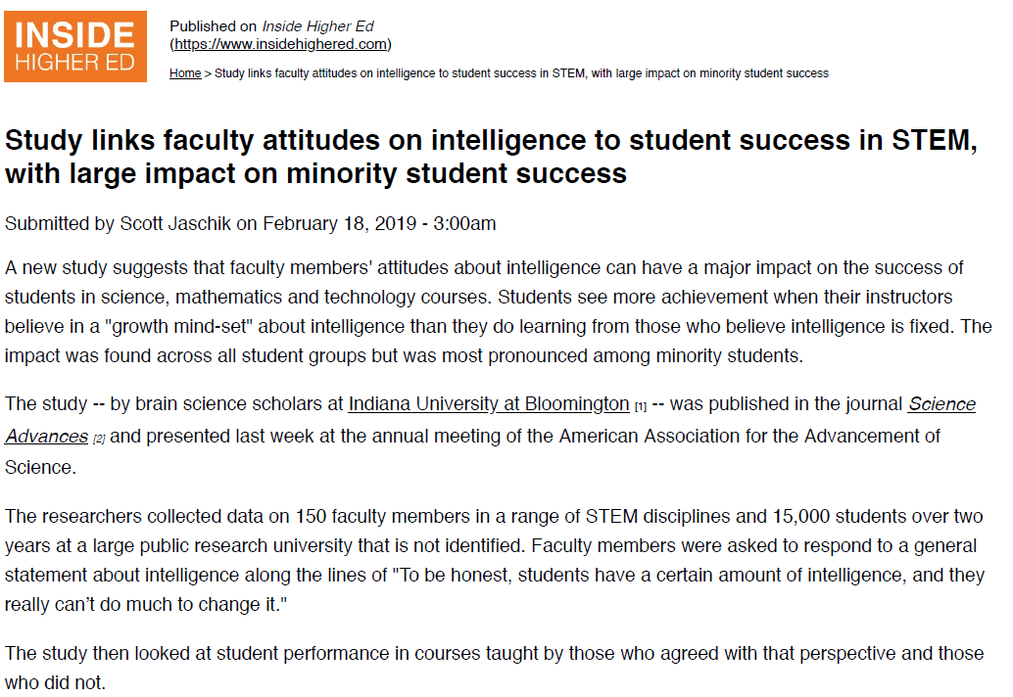

Slide 42
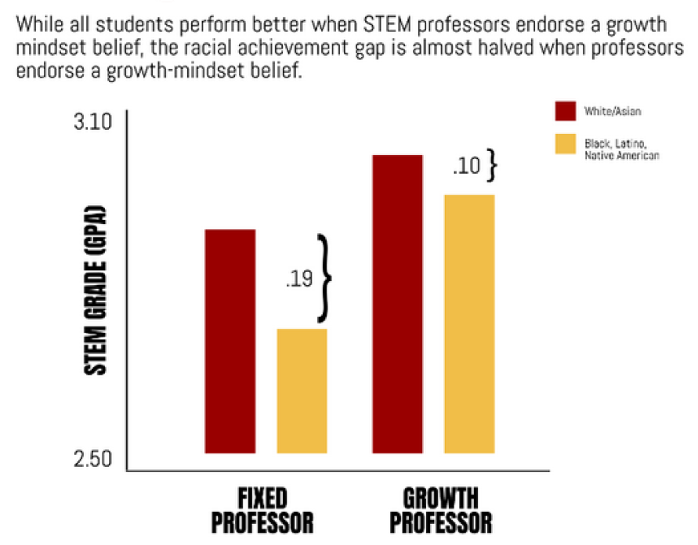
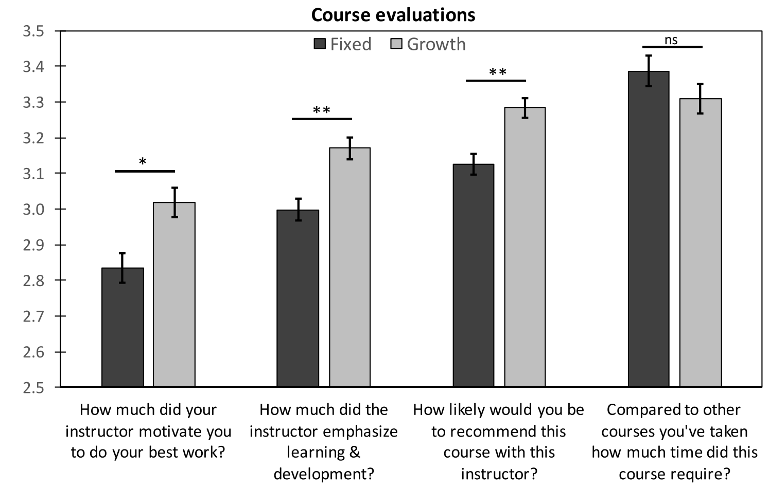
Faculty mindset beliefs predict students’ performance
in courses
Faculty mindset beliefs predict students’ experiences in courses
www.insidehighered.com/news/2019/02/18/study-links-faculty-attitudes-intelligence-student-success-stem-large-impact

Slide 43
Interview with 2021 Princeton neuroscience graduate conducted on 6/8/2021
I came from a public high school, and I struggled a lot freshman year getting used to Princeton’s culture and academics. I and my friends used to say we’re from public high schools; that’s why we’re like this. People from private high schools are in a better position because they had opportunities that we didn’t have.
The growth mindset chapter in the book was so, so important because before that I thought if you’re smart, you’re smart; if you came from a private high school you’re set; if you’re from a public high school you can’t even grow. Now I know that you have challenges that you have to overcome, but you can do better.
When I got a C in my first neuro class, the professor asked “why are you even majoring in neuro, you have a C in my class”… I got an A+ on my senior thesis… That’s one example of going from literally getting C’s my freshman year and thinking I shouldn’t be at Princeton and majoring in neuroscience to getting all A’s while taking all neuroscience courses my senior year… if it wasn’t for the growth mindset I wouldn’t be here. I now know that just because you’re from a public high school doesn’t mean you can’t thrive at Princeton.

Slide 44

What strategies can faculty implement?*
In-class activities that allow students to apply information being learned
Using questions that allow students to analyze, predict, compare approaches, etc.
Frequent in-class quizzes
Simulations that require students to solve ill-structured problems
Retrospective critique of cases to identify errors and/or exemplary performance
Compare student reasoning to that of experts
Writing assignments requiring reflection
*ADEA Commission on Change and Innovation

Slide 45

Conclusion
We can significantly increase student success in math courses by…
teaching students how to learn
helping students develop the right mindset
making the implicit explicit
not judging student potential on initial performance
encouraging students to persist in the face of initial failure

Slide 46

Acknowledgments
Sarah Baird, Learning Strategist
LSU Center for Academic Success
Dr. Elzbieta Cook, LSU General Chem Instructor
National College Learning Center Association
All of the faculty who implemented these strategies and provided feedback
All of the students who changed their attitudes and behaviors and showed me what was possible!

Slide 47
Additional References
Bruer, John T. , 2000. Schools For Thought: A Science of Learning in the Classroom. MIT Press.
Bransford, J.D., Brown, A.L., Cocking, R.R. (Eds.), 2000. How people learn: Brain, Mind, Experience, and School. Washington, DC: National Academy Press.
Christ, F. L., 1997. Seven Steps to Better Management of Your Study Time. Clearwater, FL: H & H Publishing
Cromley, Jennifer, 2000. Learning to Think, Learning to Learn: What the Science of Thinking and Learning Has to Offer Adult Education. Washington, DC: National Institute for Literacy.
Ellis, David, 2014. Becoming a Master Student*. Boston: Cengage Learning.
Hoffman, Roald and Saundra Y. McGuire. (2010). Learning and Teaching Strategies. American Scientist , vol. 98, pp. 378-382.
Nilson, Linda, 2004. Teaching at Its Best: A Research-Based Resource for College Instructors. Bolton, MA: Anker Publishing Company.
Pierce, William, 2004. Metacognition: Study Strategies, Monitoring, and Motivation.
http://academic.pg.cc.md.us/~wpeirce/MCCCTR/metacognition.htm
*Excellent student reference

Slide 48

Follow Up Activity
Choose 2 to 3 strategies that you would like to teach your students
Share with a colleague how you plan to present it to the students.

