Slide 1
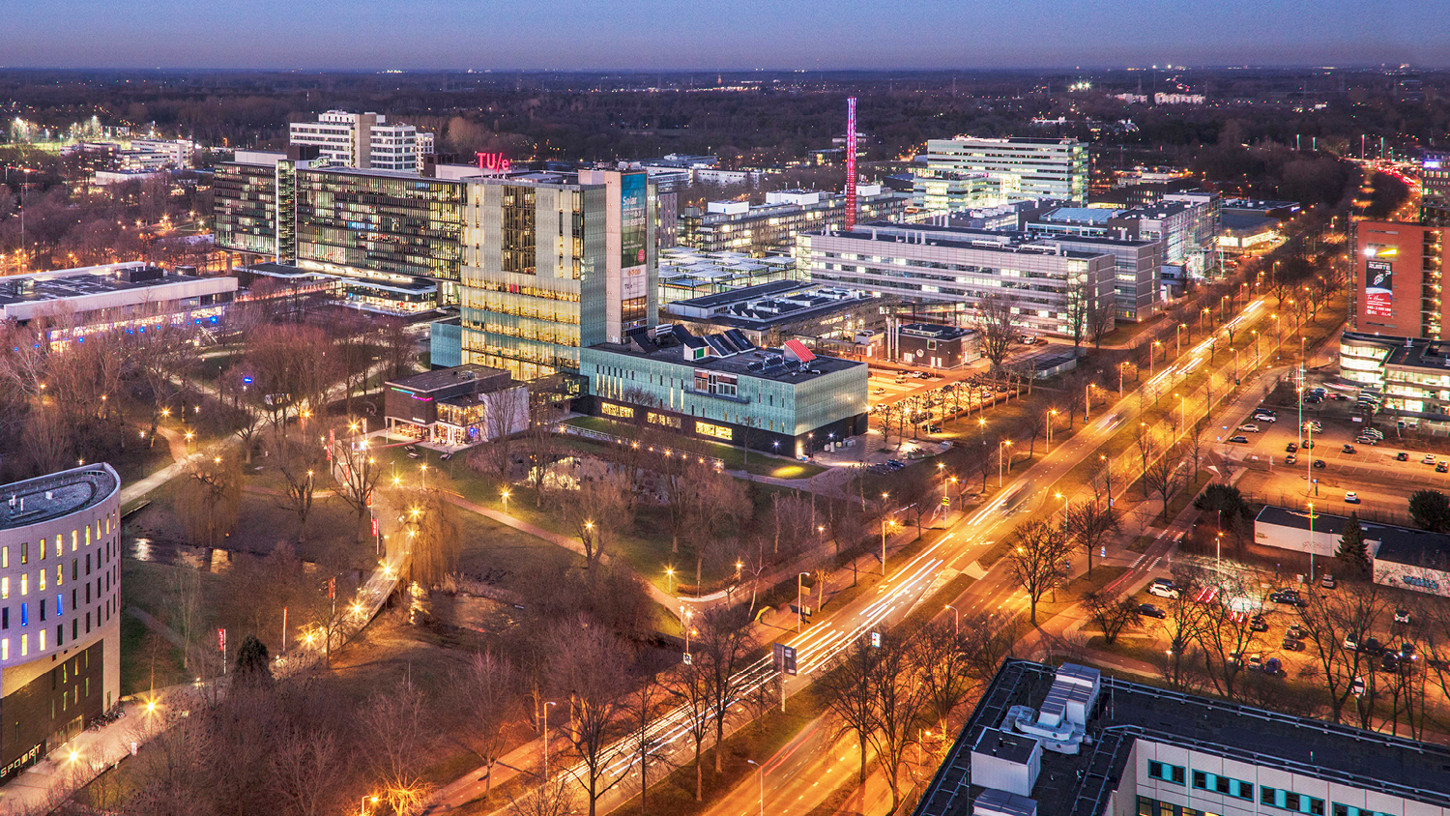
Teaching How to Write Proofs in Linear Algebra
OLSUME ocober 7, 2025
Nelly Litvak
Department of Mathematics and Computer Science

Slide 2

Joint work with Lotte Weedage
2014: Freshman student in the first edition of the course
2018-2022: TA and co-developer of the course
2023: Instructor

Slide 3
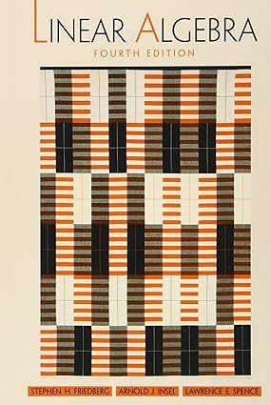
Linear structures 1
40-60 students, mostly freshmen Applied Mathematics
2-3 instructors
8 weeks + exam
2014-2023 University of Twente, the Netherlands
Linear algebra. S. H. Friedberg, A. J. Insel, L. E. Spence.— 4th ed. p. cm. Includes indexes. ISBN 0-13-008451-4

Slide 4
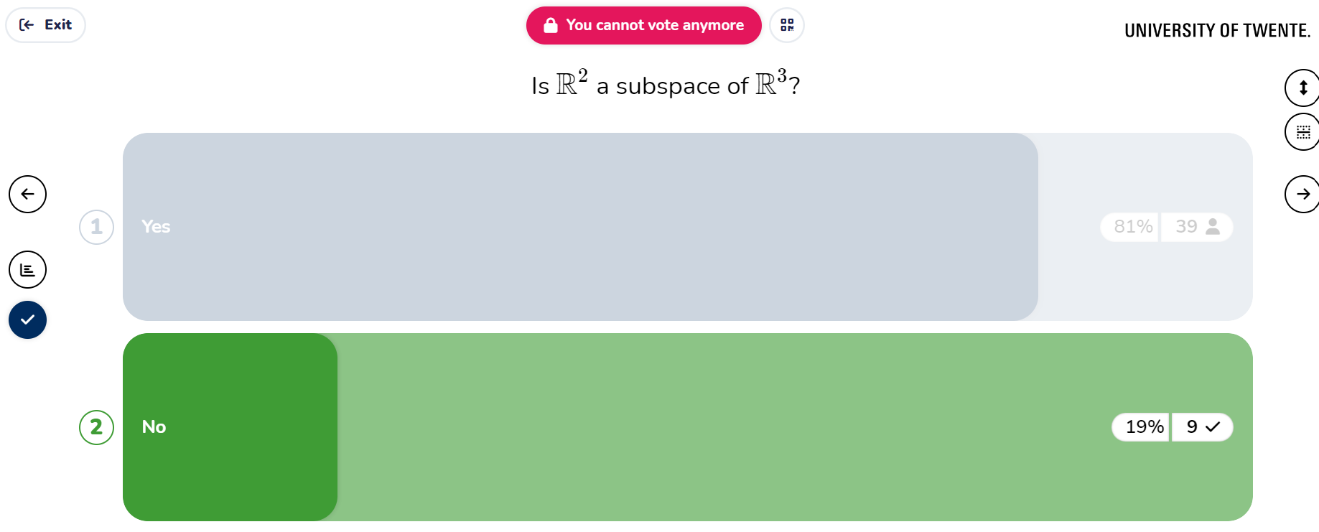

Slide 5
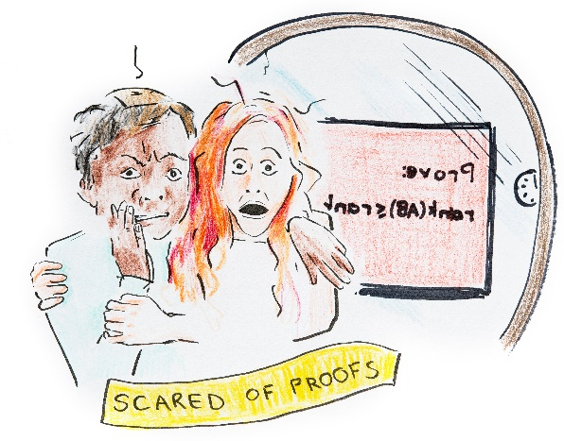
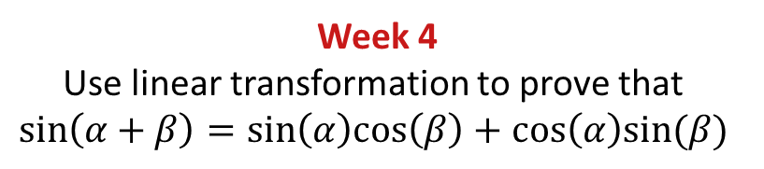
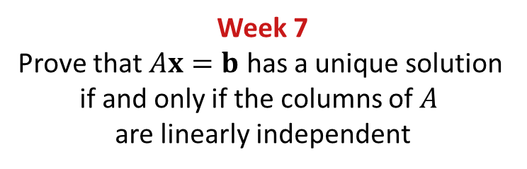
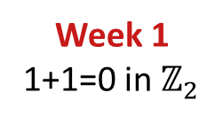
Week 1
1+1=0 in $ℤ_{2}$
Week 2 Prove that in any vector space 0 vector is unique
Week 4
Use linear transformation to prove that
$$sin\left(α+β\right)=sin\left(α\right)cos\left(β\right)+cos\left(α\right)sin⁡(β)$$
Week 7
Prove that $Ax=b$ has a unique solution if and only if the columns of $A$ are linearly independent
Drawing: Eline van Hoven

Slide 6
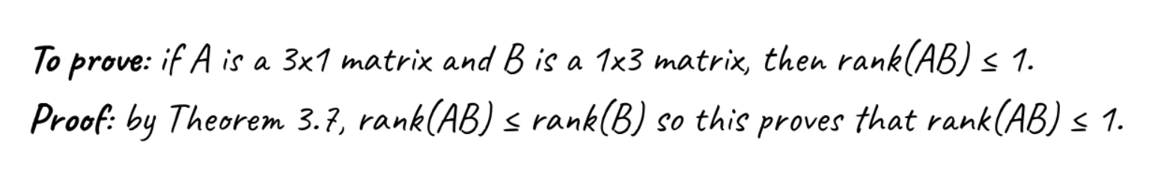
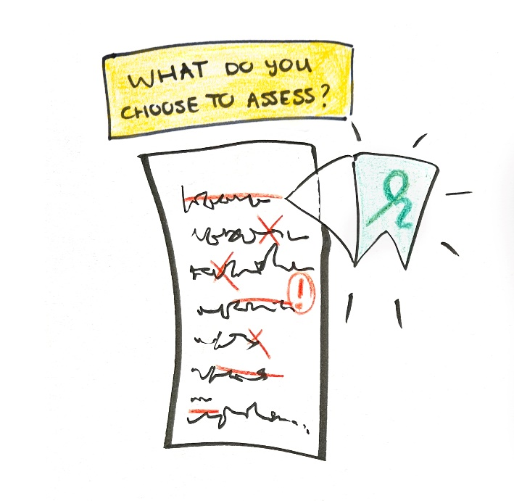
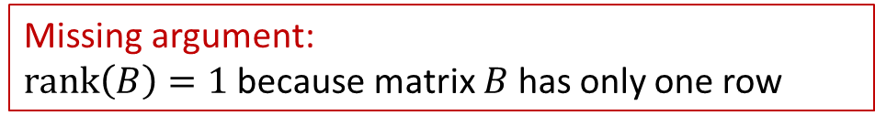
Missing argument: $rank\left(B\right)=1$ because matrix $B$ has only one row
Drawing: Eline van Hoven

Slide 7








Preparation at home
In the class
Mandatory submission,
no grade
Studying the material
Interactive videos, textbook
online homework quiz
interactive lectorial
Exam part 1
Practice exercises
Practice exercises
Tutorials
Proof of the week
Exam part 2
group discussion,
feedback
submit corrected
version
Write Pólya’s four steps

Slide 8
Preparation at home
In the class
Mandatory submission,
no grade
Studying the material
Interactive videos, textbook
online homework quiz
interactive lectorial
Exam part 1
Practice exercises
Practice exercises
Tutorials
Proof of the week
Exam part 2
group discussion,
feedback
submit corrected
version
Write Pólya’s four steps

Slide 9

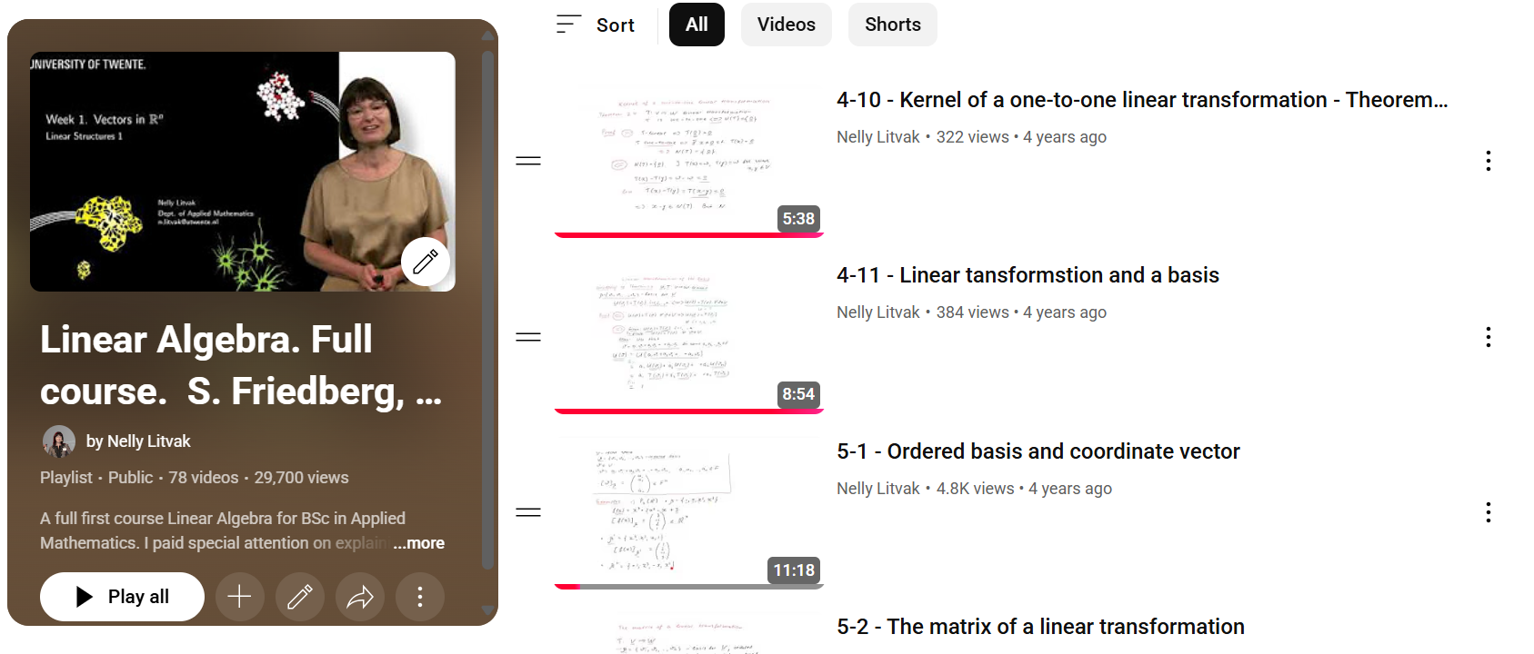
YouTube playlist

Slide 10
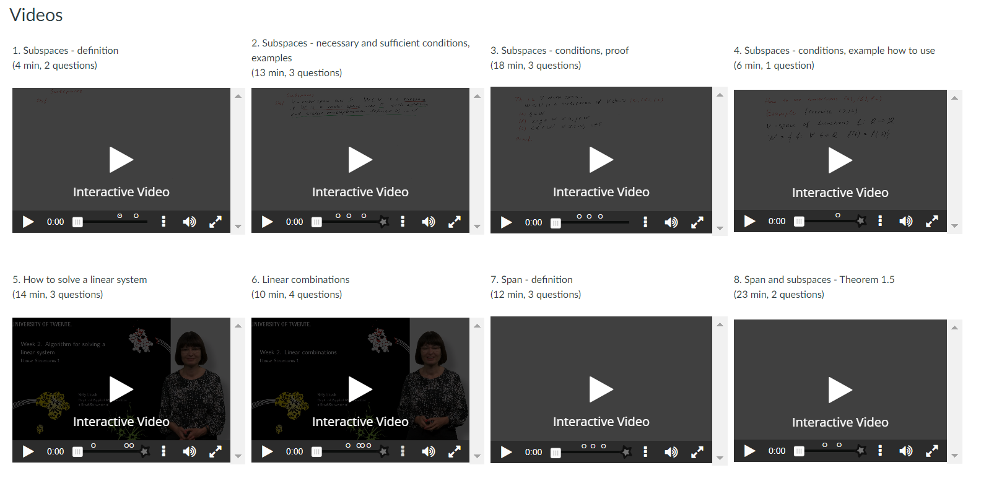
Videos shared on Canvas with interactive questions inserted with H5P
Notes:
Block about my iccovations 11-15’

Slide 11




Open questions
`We have proved a), how will you prove b)?’
`Mouse-click’ questions
multiple choice
drag-and-drop
sometimes final answer
“They ask me something that I don’t know yet”

Slide 12
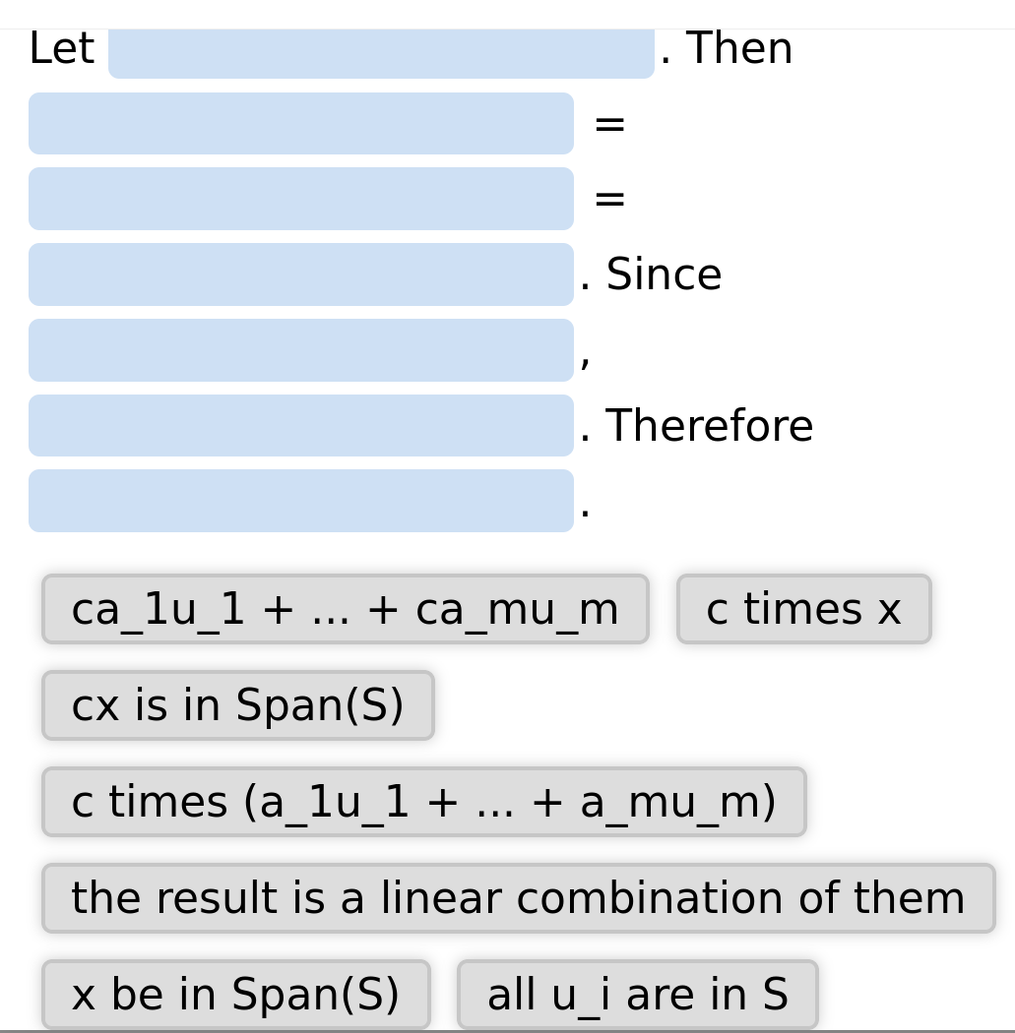
H5P. Reconstruct the proof: $x∈ Span\left(S\right)⟹cx∈Span(S)$

Slide 13
Preparation at home
In the class
Mandatory submission,
no grade
Studying the material
Interactive videos, textbook
online homework quiz
interactive lectorial
Exam part 1
Practice exercises
Practice exercises
Tutorials
Proof of the week
Exam part 2
group discussion,
feedback
submit corrected
version
Write Pólya’s four steps

Slide 14
interactive lectorial
Very brief recap of the main definitions and statements
Online questions as in Exam part 1. No grade.
Feedback on the answers and the errors

Slide 15
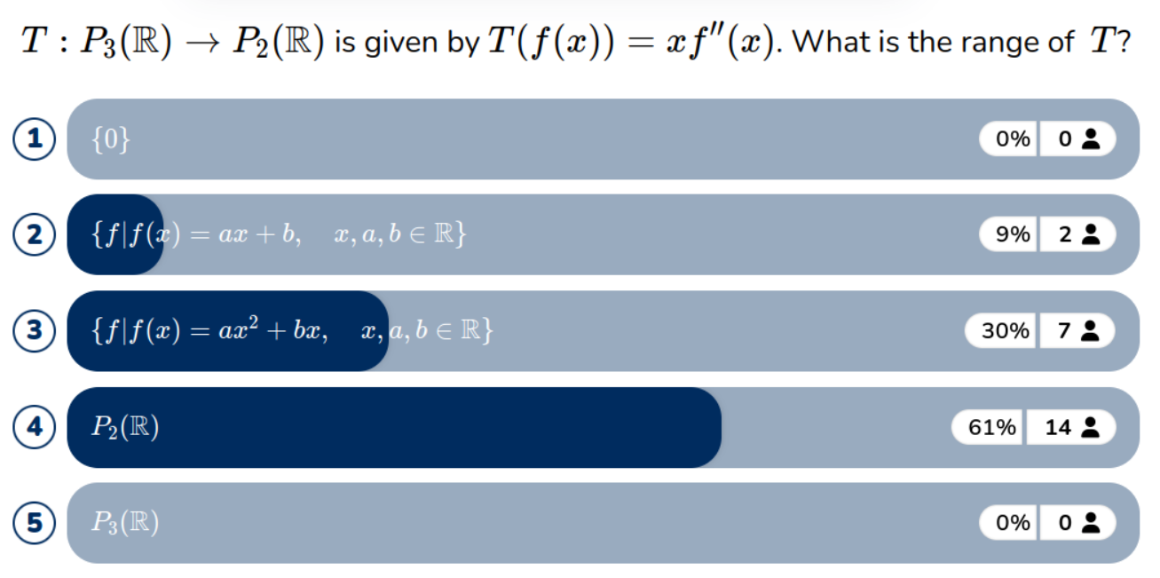


Slide 16
Preparation at home
In the class
Mandatory submission,
no grade
Studying the material
Interactive videos, textbook
online homework quiz
interactive lectorial
Exam part 1
Practice exercises
Practice exercises
Tutorials
Proof of the week
Exam part 2
group discussion,
feedback
submit corrected
version
Write Pólya’s four steps

Slide 17

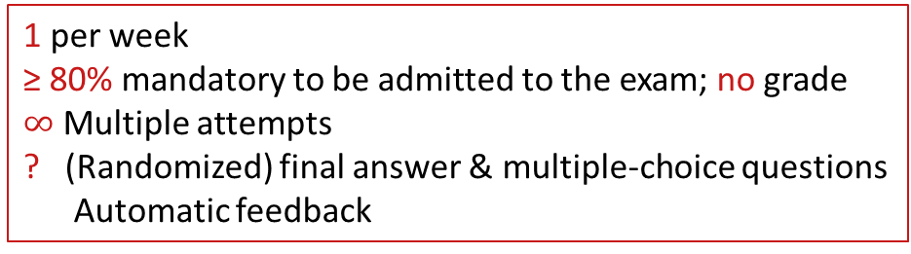
online homework quiz
1 per week
≥ 80% mandatory to be admitted to the exam; no grade $∞$ Multiple attempts
? (Randomized) final answer & multiple-choice questions
Automatic feedback
Individual practice
Check understanding

Slide 18
Preparation at home
In the class
Mandatory submission,
no grade
Studying the material
Interactive videos, textbook
online homework quiz
interactive lectorial
Exam part 1
Practice exercises
Practice exercises
Tutorials
Proof of the week
Exam part 2
group discussion,
feedback
submit corrected
version
Write Pólya’s four steps

Slide 19
Proof of the week
Proof of the week
group discussion,
feedback
submit corrected
version
Write Pólya’s four steps
Exam part 2
Miller, K., Zyto, S., Karger, D., Yoo, J., & Mazur, E. (2016). Analysis of student engagement in an online annotation system in the context of a flipped introductory physics class. Physical Review Physics Education Research, 12(2), 020143.
Mazur, E. (2016) Syllabus of Applied Physics 50a, Harvard University. Private communication.

Slide 20
Preparation at home
In the class
Mandatory submission,
no grade
Studying the material
Interactive videos, textbook
online homework quiz
interactive lectorial
Exam part 1
Practice exercises
Practice exercises
Tutorials
Proof of the week
Exam part 2
group discussion,
feedback
submit corrected
version
Write Pólya’s four steps

Slide 21
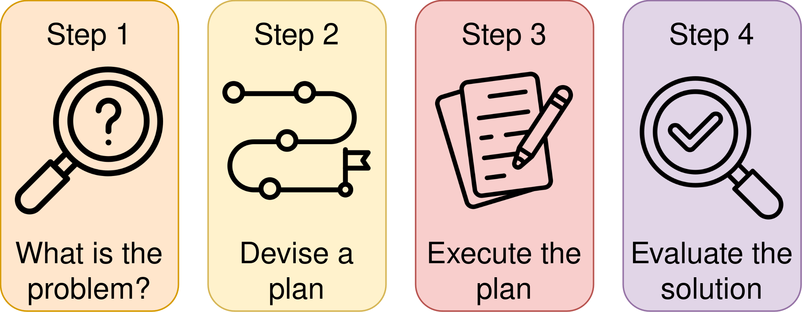
One (!) challenging problem per week
Must work individually at home
Solution must be written in Polya’s four steps
Mandatory, no grade
Write Pólya’s four steps
Polya, G. (1957). How to solve it.

Slide 22
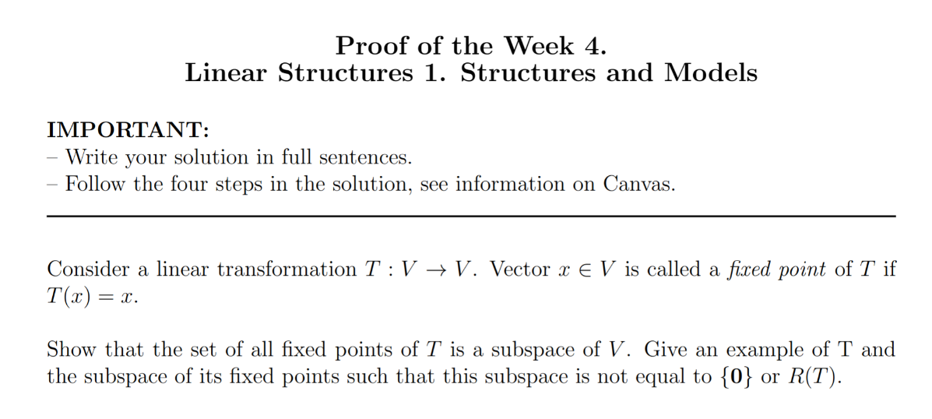

Slide 23
Can you break down the conditions?
What each condition means? What is the intuitive interpretation of this result/problem?
Can you give an example?
Can you give a counterexample?
Can you draw an illustration?

Slide 24
What results and mathematical relations are relevant?
Are the assumptions of these mathematical relations met?
Which executable steps should I make?
You should be able to finish the plan with the phrase: ‘And this will solve the problem’

Slide 25
Carry out your plan, explaining each step.
The argument should be easy to follow.
Articulate your thought process at each step (including roadblocks).
All variables should be clearly defined, and your diagrams should be labelled.

Slide 26
Does the result make sense in extreme or special cases?
Can you interpret the solution and/or the result intuitively?
Did you use all conditions?
Which role each condition played in the solution?
Could you relax some assumptions?
Is the problem related to other problems or results?
If relevant, what are the implications of all above in practice?

Slide 27
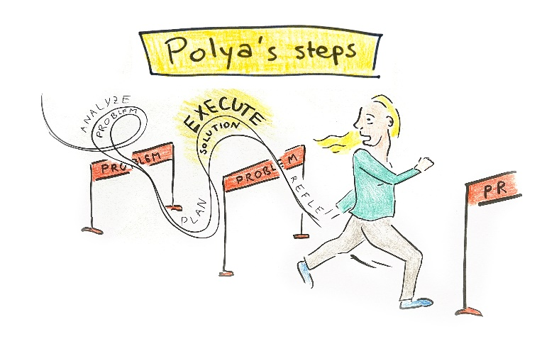
What students see as “the” solution
Very difficult!
Drawing: Eline van Hoven

Slide 28
Preparation at home
In the class
Mandatory submission,
no grade
Studying the material
Interactive videos, textbook
online homework quiz
interactive lectorial
Exam part 1
Practice exercises
Practice exercises
Tutorials
Proof of the week
Exam part 2
group discussion,
feedback
submit corrected
version
Write Pólya’s four steps

Slide 29

group discussion,
feedback
Discuss solutions in groups of 4-5 students
Write down 2 steps of group solution
Detailed solutions published
Live feedback to groups by the teacher
≈ 45-60 min
≈ 30-45 min

Slide 30
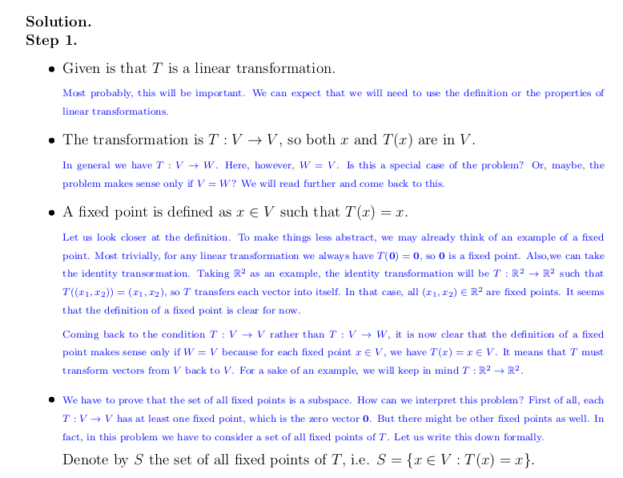

Slide 31
Preparation at home
In the class
Mandatory submission,
no grade
Studying the material
Interactive videos, textbook
online homework quiz
interactive lectorial
Exam part 1
Practice exercises
Practice exercises
Tutorials
Proof of the week
Exam part 2
group discussion,
feedback
submit corrected
version
Write Pólya’s four steps

Slide 32
submit corrected
version
Make corrections in the individual solution with a red pen Solution must be written in Polya’s four steps
Submission must show serious effort
Mandatory to be admitted to the exam
No grade

Slide 33
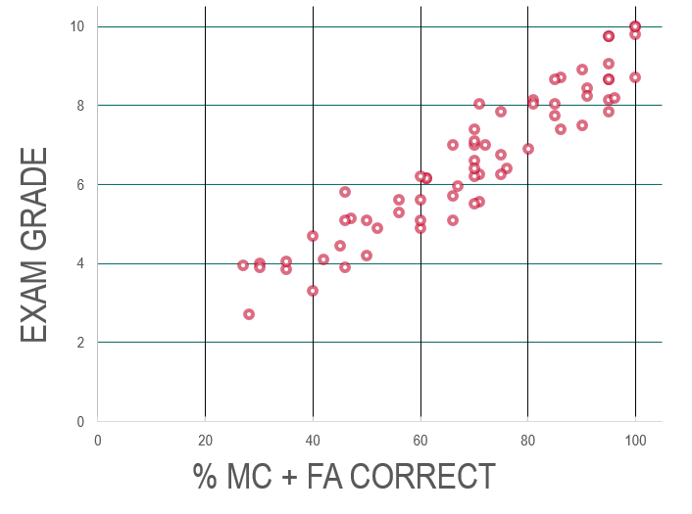
Exam
≥ 50%
Exam part 1
Exam part 2
10 questions
2 problems

Slide 34
Grading proofs
Correctness: 2 points Write-up: 2 points
2 points
2 points
2 points

Slide 35
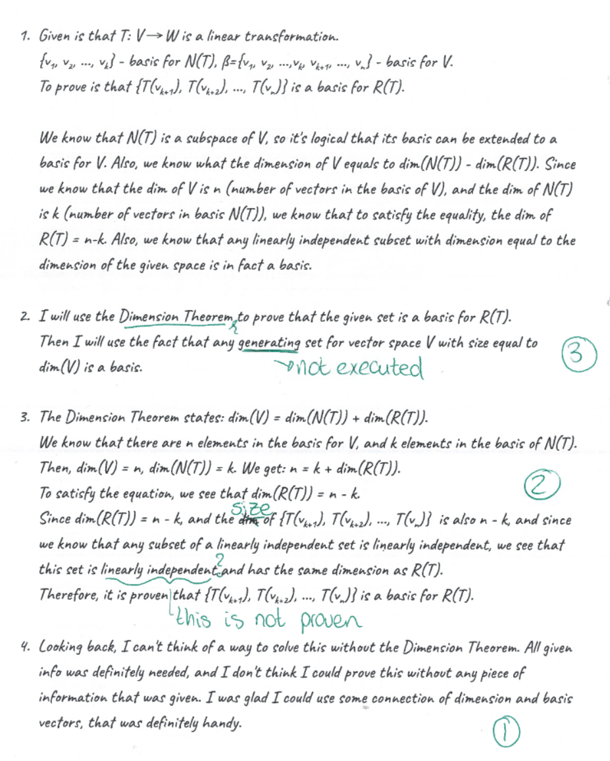

Example students’ solution
Better quality of proof writing
Grading reduced 4-5 times (due to part 1)
More fun to grade

Slide 36
Preparation at home
In the class
Mandatory submission,
no grade
Studying the material
Interactive videos, textbook
online homework quiz
interactive lectorial
Exam part 1
Practice exercises
Practice exercises
Tutorials
Proof of the week
Exam part 2
group discussion,
feedback
submit corrected
version
Write Pólya’s four steps

Slide 37
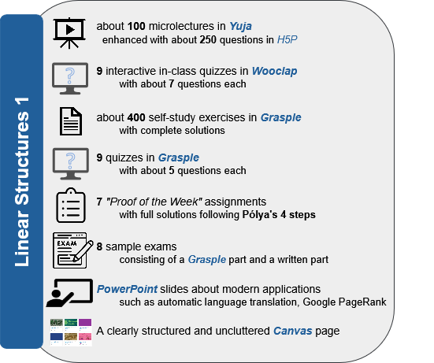

Slide 38
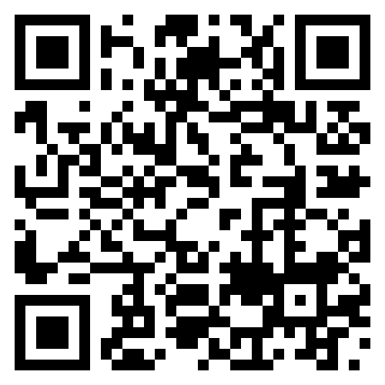

Litvak, N., & Weedage, L. (2024). Teaching the skill of writing a mathematical argument in a first-year linear algebra course. University of Twente preprint.
Complete course materials Linear Structures 1
https://doi.org/10.5281/zenodo.12779750
Lotte Weedage (Eindhoven University of Technology)
Lavinia Lanting (University of Twente)
Jasper de Jong (University of Twente)

