Slide 1
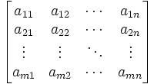
Making Linear Algebra Student-friendly by Re-ordering the Topics and Adapting the Tone
JAMES MCCLURE
PURDUE UNIVERSITY
Notes:
As this title graphic is meant to convey, linear algebra is an obstacle course for many students…

Slide 2
Obstacles to learning linear algebra:
Conceptual thinking is mandatory
Words and sentences are as important as equations
Vocabulary
Proofs
Information overload
Notation
Set theory
double indices
Hard to know what the purpose of the concepts is

Slide 3
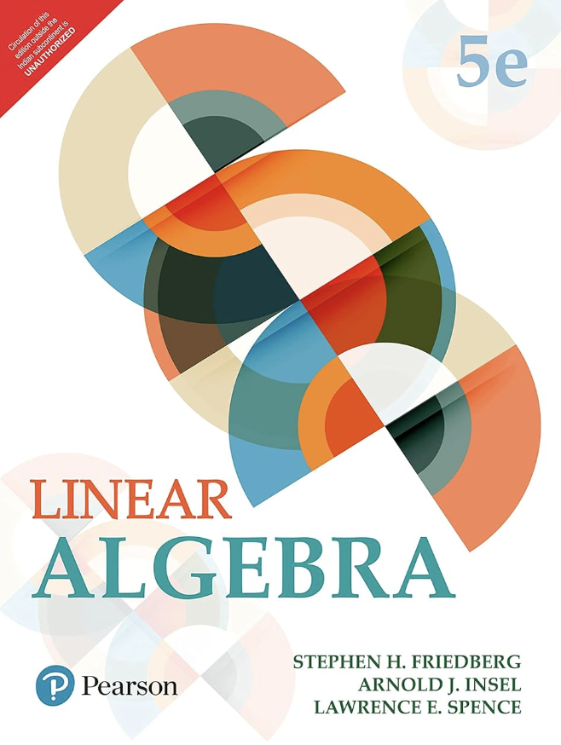
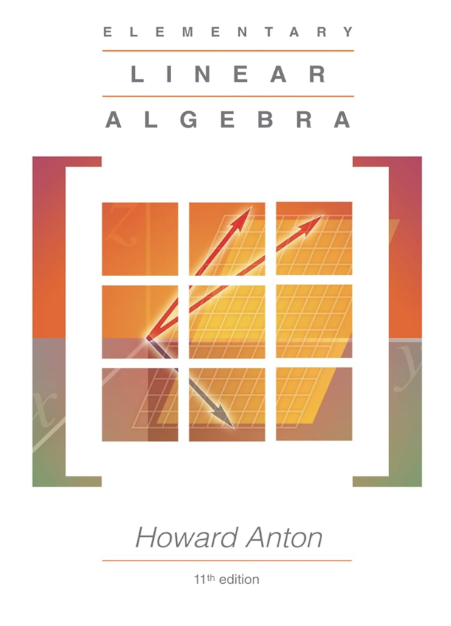
Typical organization of a linear algebra textbook
Early chapter on systems of linear equations
Early chapter on elementary theory of matrices
including factorization into elementary matrices
transposes, symmetric matrices
diagonal and triangular matrices
matrix form of a linear system
inverses
After that chapters covering (in some order)
subspaces (null space, column space)
linear combinations
linear independence
spanning sets
bases and dimension
vector spaces and linear transformations
determinants
eigenvalues and eigenvectors
orthogonality, if time allows

Slide 4
How the usual organization contributes to the obstacles
Chapter on matrices has miscellaneous assortment of concepts and formulas
contributes to information overload and to lack of purpose
First part of the course is mainly computational, then abrupt shift in emphasis to concepts
no explanation of why this is happening.
When new concepts (such as subspace) are introduced, not possible to give a persuasive reason for them
homework on these conceptual topics is mostly routine and doesn't involve significant thinking
Eigenvalues and eigenvectors come late in the semester, often at the end
doesn't give students a chance to live with this important topic and build it into their thinking

Slide 5
WHAT CAN BE DONE TO ADDRESS THESE OBSTACLES?
Notes:
Some eliminated, some smoothed

Slide 6
a strategy for dealing with obstacles: NARRATIVE ARCS
Analogy:
When we watch a TV series or read a novel, we can digest a lot of information about the characters and the situation because it's part of the story
They don't tell us everything at the beginning; they add information gradually

Slide 7
Covenant of the arc:
First arc: Diagonalization
Three subarcs:
2 x 2 diagonalization
Examples of 3 x 3 and 4 x 4 diagonalization
n x n diagonalization
Second arc: Orthogonality
Three subarcs:
Linear regression
Orthogonal diagonalization
Singular value decomposition
Introduce new concept only when it has work to do in the (sub)arc
One big advantage of organization by arcs: can always explain the purpose of each new concept
Notes:
EXPLAIN ONLY LOOKING AT THE FIRST ARC; WHAT’S COVERED IN THE FIRST SEMESTER

Slide 8
first subarc: 2 x 2 diagonalization
The topics that are needed to get to 2 x 2 diagonalization are:
2 x 2 systems of linear equations
Matrix multiplication
Determinants and inverses of 2 x 2 matrices
Bases for ℝ²
In my version, it takes only 3-4 weeks of classes to get there

Slide 9
Chapters in the first subarc
CHAPTER 1 covers 2 x 2 and 3 x 3 systems algebraically and geometrically
CHAPTER 2 introduces “linear filters”
I begin by mentioning some applications
A matrix is an efficient way to write the information in a linear filter
The matrix of a composite filter is the product of the matrices, which explains why matrix multiplication is associative and unital but not commutative
No discussion of matrix addition and distributivity until Chapter 11; nor of transpose until Chapter 18 (which helps to avoid information overload)
No discussion of other ways of thinking about matrix multiplication (for example, j-th column of AB is A times j-th column of B) until they're needed (much later)
Linear filter

Slide 10
CHAPTER 3:determinants and inverses of 2 x 2 matrices
Begins with motivational teaser about eigenvalues and eigenvectors
Then a short introduction to logic: a discussion of what truth is and why we need proofs to get to truth
Then a discussion of $⟹$ statements, converses, and $⟺$statements
First explanation (proof) in the book (see right):
Explanations are designed to capture the thinking while avoiding as much as possible of the formalism
Chapter also introduces inverses and gives the formula for the inverse of a 2 x 2 matrix; the details in the explanation of this formula are homework problems

Slide 11
CHAPTER 4: linear coordinate systems
Begin by situating Chapter 4 in the narrative:
The goal of Chapter 4 is to explain linear changes of coordinates, using vectors
A basis is a basis for a coordinate system
A pair of vectors in ℝ² is a basis $⟺$the vectors are nonparallel

Slide 12
CHAPTER 5: Diagonalization of 2 x 2 filters
The chapter begins by examining what property $\vec{v_{1}}$ and $\vec{v_{2}}$ must have if the pair $\vec{v_{1}}$ , $\vec{v_{2}}$ diagonalizes the filter with matrix A
This leads directly to the definition of eigenvector
Then the chapter shows how to find eigenvalues and eigenvectors; for this we need the concept of homogeneous system

Slide 13
Homework FROM CHAPTER 5
In Chapter 5, I begin assigning homework problems that require more thought about concepts

Slide 14
CHAPTER 6
TWO APPLICATIONS OF 2 x 2 DIAGONALIZATION
Uses diagonalization to solve 2 x 2 systems of linear differential equations with constant coefficients
CHAPTER 7
Uses diagonalization to solve 2 x 2 systems of recurrence relations and to find the formula for the Fibonacci numbers
END OF FIRST SUBARC

Slide 15
second subarc:
The purpose of the second subarc is for students to get experience with 3 x 3 and 4 x 4 diagonalization and to start moving toward the general theory

Slide 16
CHAPTER 8
Solutions of n x n systems
Gives the standard information about this (non-square systems are discussed later)
CHAPTER 9
Determinants and inverses of n x n matrices, and linear coordinate systems in ℝ^{n}
Uses the fact that the j-th column of AB is A times the j-th column of B
Goes through 3 x 3 determinants carefully and gives a reference for n x n
Geometric description of bases in ℝ³
Then bases in ℝ^{n}

Slide 17
CHAPTER 10
Examples of diagonalization of 3 x 3 with distinct eigenvalues, 3 x 3 with double eigenvalue that has nonparallel eigenvectors, and similarly for 4 x 4
Example of nondiagonalizable 3 x 3 and an example where we can't yet decide diagonalizability.
Introduces the contrapositive

Slide 18
CHAPTER 11: LINEARITY AND INDEPENDENCE
Goal of this chapter is to prove the general statements about 3 x 3 and 4 x 4 diagonalization that are suggested by the examples in Chapter 10
Proves that multiplication of a vector by A preserves addition and scalar multiplication
Introduces linear independence
Uses these two ingredients to prove that a 3 x 3 with distinct eigenvalues is diagonalizable, and similarly for 4 x 4. Then students are asked for 5 x 5 on homework
Also uses these ingredients to prove that a 3 x 3 with a double eigenvalue that has a nonparallel pair of eigenvectors is diagonalizable. Then students are asked for the corresponding 4 x 4 case on homework, and also for two double eigenvalues with nonparallel pairs of eigenvectors
Chapter concludes with two 4 x 4 examples where we can't yet decide about diagonalizability. This sets the stage for the next chapter, on subspaces
END OF SECOND SUBARC

Slide 19
third subarc:
n x n diagonalization
The third subarc completes the account of diagonalization, using the theory of subspaces

Slide 20
CHAPTER 12: subspaces pt. 1
Introducing the concept of subspace, selling it, and applying it to diagonalization
Definition of subspace and main examples, including eigenspaces
Classification of subspaces of ℝ²
Linear combinations and their relation to linear independence
Classification of subspaces of ℝ³
Basis and dimension (the explanation of why dimension is well-defined is later, Chapter 14)
Brief description of applications to data science
Application to diagonalization: 5 x 5 with 2- and 3- dimensional eigenspaces, with similar examples for homework
Then I say: These ideas can be used to show (*) If the dimensions of the eigenspaces add to n then A is diagonalizable

Slide 21
Chapter 14: subspaces pt. 2
Chapter 14 gives the proof of (**) and uses it to complete the diagonalization story
Shows dimension is well-defined
The chapter concludes by introducing the concept of span and using it, together with facts from earlier in the chapter, to prove that every subspace of ℝ^{n} has a basis
It remains to show the converse of (*)
The key ingredient for this is:
(**) A subspace with dimension k can't have a linearly independent subset with more that k elements
To prepare for this, CHAPTER 13 discusses non-square linear systems, divided into two types, wide and tall
The fact needed for (**) is that a wide homogeneous system has nonzero solutions
END OF THE
THIRD SUBARC;
FIRST ARC COMPLETE

Slide 22
The next two chapters apply the concepts already developed to complete the first-semester material
Chapter 15 gives the definition of rank and its properties
Chapter 16 is an account of vector spaces, with applications to linear differential equations

Slide 23
Quick summary of the organizing principles of the first semester:
Eigenvalues early, starting with 2 x 2
Bases before linear independence before linear combinations before span
Subspaces late, when there's a convincing application for them

Slide 24
Avoiding obstacles from language
Notes:
FINIShed covering Narrative arcs, and how they can provide students with a sense of purpose, momentum, and mastery
WANT to end by discussing another key strategy I follow in the book:

Slide 25
Example
This requires significant unpacking:
"one" here (but not always) means at least one
the zero vector plays a special role: it's a multiple of every vector but no nonzero vector is a multiple of it
The definition I use is:
A standard way to define parallel vectors is:
Two vectors are parallel $⟺$one of them is a multiple of the other.
When in doubt,
spell it out!

Slide 26
Even the word "true" has a technical meaning in mathematics:

Slide 27
I don't use quantifiers. Instead of saying “Every matrix with distinct eigenvalues is diagonalizable” I say “If a matrix has distinct eigenvalues, then it's diagonalizable”
The point is that to prove a “For every” statement we have to first translate it into an if-then statement, which would add to the number of things the students have to remember
Set theoretic language and symbolism can also be an obstacle. I only use it for working with vector spaces
I don't use double indices or sigma notation

Slide 28
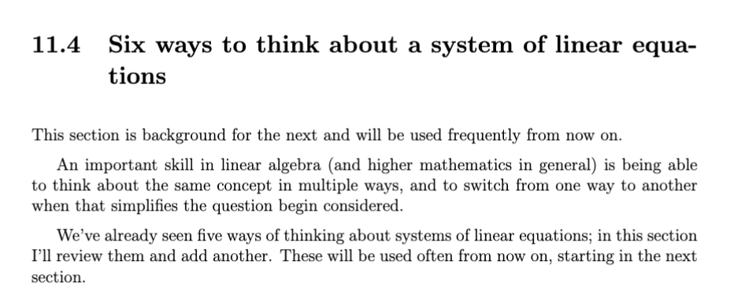
Conversational
tone,
not professorial
tone
From Section 1.1: 2 x 2 systems of linear equations
From Section 11.4: Six ways to think about a system of linear equations

Slide 29
AN INTRODUCTORY TEXTBOOK AIMED AT STUDENTS, NOT PROFESSORS
LINEAR ALGEBRA FOR STUDENTS
Notes:
Book plug

