Slide 1
Exploring tutoring interactions: What moves to undergraduate mathematics tutors make?
Melissa Mills
October 8th, 2024

Slide 2
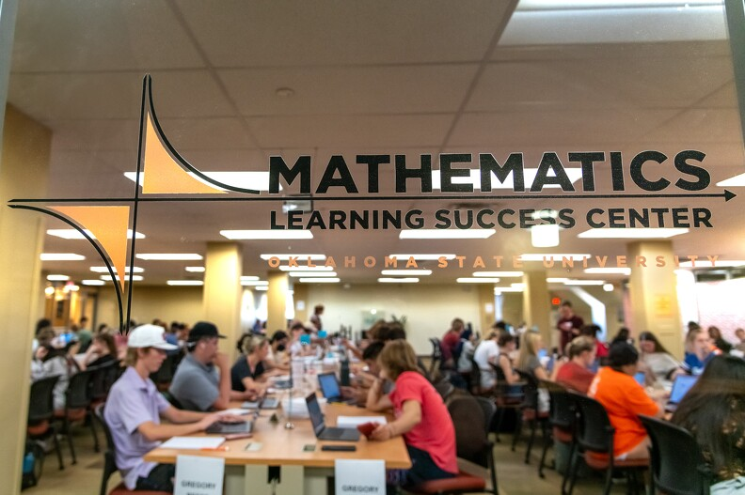

Slide 3
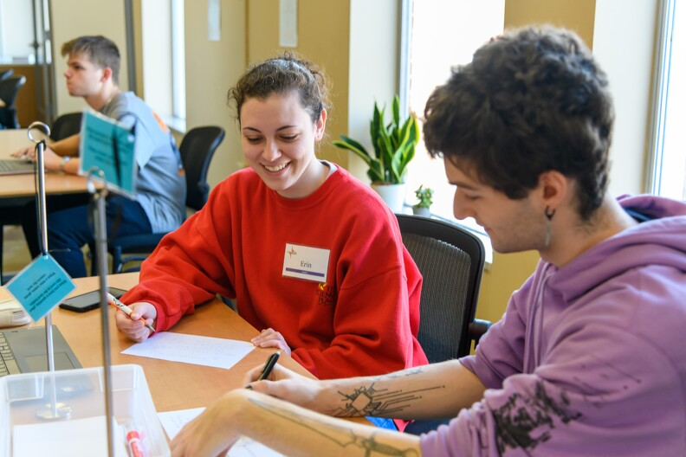

Slide 4
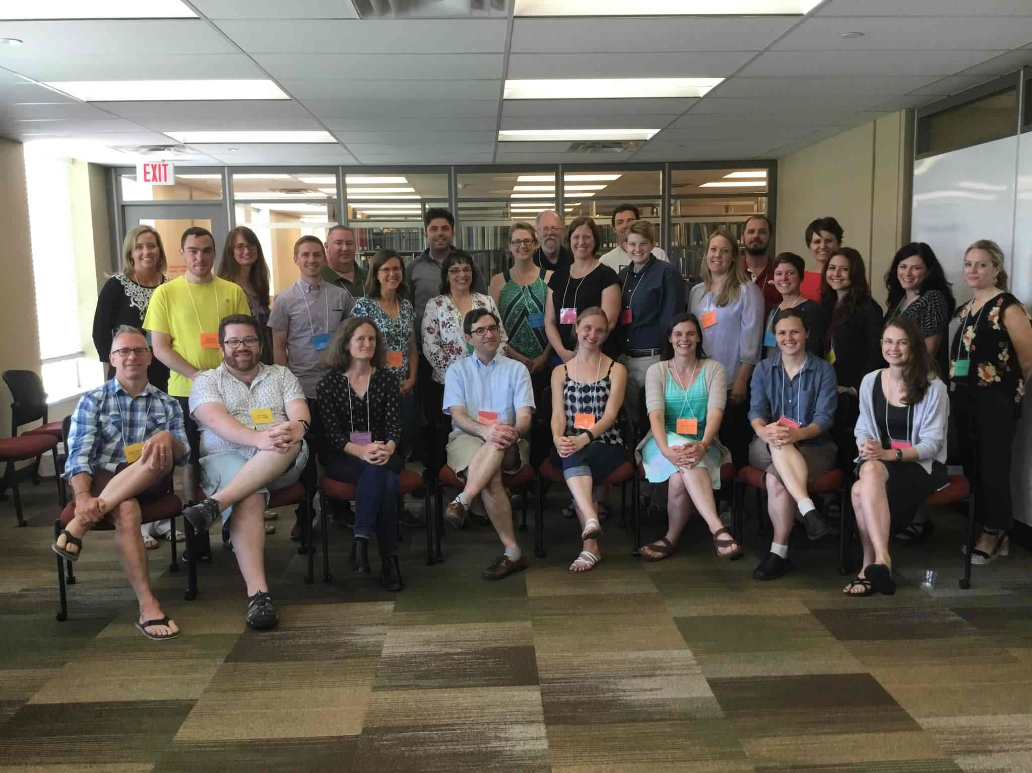
Mathematics Learning Resources Leadership Workshop (NSF # 2645086)
May 2017
May 2018

Slide 5
Research themes from workshop
National Survey (Mills, Rickard, & Guest, 2020)
How do tutoring centers in the USA operate on a day-to-day basis?
Quantitative Analysis – Creating a standard for how we analyze our quantitative data. (Byerley, et al., 2022; Johns, et al., 2021)
What are the impacts of organizational decisions for a tutoring center?
Tutor Interactions (Johns, et al. 2022)
What happens during a tutoring session? Can we influence tutor behaviors with training?
Mathematical Knowledge for Tutoring (Johns & Burks, 2022)
Beginning of Math Learning Center Leaders (MLCL) group – Biweekly online meetings for math center leaders, shared google drive with resources.

Slide 6
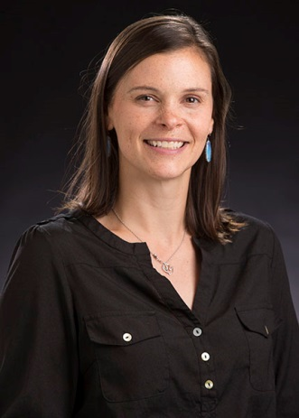
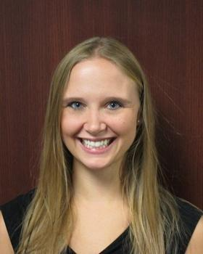
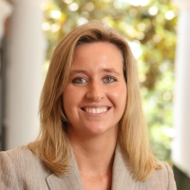
Melissa Mills
Oklahoma State University
Director of the Mathematics Learning Success Center
Megan Ryals
University of Virginia
Assistant Professor
Previously the Assistant Director of NC State’s University Tutorial Center for 14 years
Carolyn Johns
The Ohio State University
Assistant Director of the Mathematics and Statistics Learning Center

Slide 7
Benefits of Tutoring
More interactive, immediate feedback, increases in confidence (Topping, 1996)
Improved affect towards mathematics (CSPCC; Mac an Bhiard, Mogan & O’Shea, 2009)
Improved grades (Rickard & Mills, 2018; Byerley, Campbell, & Rickard, 2018; Xu, Hartman, Uribe, et al., 2001)

Slide 8
What is considered “effective” tutoring?
Tutor asks appropriate questions and scaffolds the learning in response to students (Graesser et al., 2011; Roscoe & Chi, 2007; Topping, 1996)
Student is involved in active inquiry and generates self-explanations (Chi, 1996; Lepper and Wolverton, 2002; Topping, 2005; Van Lehn, 2011)
Most of these results are NOT math-specific!

Slide 9
What happens during a mathematics tutoring session?
Few studies have examined this in detail.
Tutors dictate the direction of the session (Chi et al, 2001; Graesser, Person, & Magliano, 1995)​
Tutors carry out the majority of the mathematical reasoning (James & Burks, 2018)
Tutors miss opportunities to address misconceptions (Chi, 1996)​

Slide 10
“Effective” Mathematics Teaching
“Effective teaching involves observing students, listening carefully to their ideas and explanations, having mathematical goals, and using the information to make instructional decisions” (NCTM, 2000)

Slide 11
Do undergraduate peer tutors do this?
For the most part, no.
But there is still an overall positive effect: (From Byerley et al 2022, multiple regression, controlling for prior mathematical ability):
5/10 had statistically significant positive correlation.
2/10 had statistically significant negative correlation.
3/10 had no significant correlation.
So what are tutors doing? And why might it be supporting student learning?

Slide 12
Decentering?
Mills Johns Ryals (2019) Tutor Decentering
Mostly tutors don’t decenter in the moment, but we have evidence that reflections on tutoring episodes can aid tutors in forming questions that bring out student thinking.
(But really… Is it surprising that tutors struggle to enact behaviors that experienced teachers don’t always enact?)
Anti-Deficit Approach…

Slide 13
Analysis of 31 tutor transcripts
Select grain size – We chose tutor talking turn as our grain size
Coded based on White & Mesa’s (2014) cognitive orientation framework

Slide 14
Supplied Facts
“So the amplitude is going to be the distance between the midline and the maximum or minimum point.”
“f (x) = e^x …What’s its derivative?”
Applied a Procedure – One of the most common ways tutors engaged students
“now we can plug these into our formula. So, we know g (t + h) = 4 (t + h) + 5 and we know g (t) and we’re subtracting off g (t) and it’s 4t + 5 and all over h .”
“what is the integral of 3x?”

Slide 15
Determined What to do
“we know this [pointing to (g(t+h)−g(t))/h ] looks an awful lot like the slope y2 − y1. So now we just need to find g (t). So, g (t) is pretty simple because we’re plugging t in for t , right?”
“what can I do with my derivative to find [the critical] points?”
Drew Upon Understanding
“that’s the whole idea of completing the square. We’re turning this term here into something squared. So that’s the importance of why we had to take that negative one out, because if we were to leave the negative one in here, it would mess things up.”
a tutor asked a student to identify the function type of y = 2x + 5, which required the student to extract information from the function to classify it.
Tutors were more likely to elaborate on responses and provide lengthy explanations, while students were being asked pointed questions that were likely to be evaluated by the tutor rather than used for probing student understanding.

Slide 16
Immediately Reduced Cognitive Orientation
Tutor: Not quite, so let’s just look at the denominator, in order to subtract five from 1/t, how would we do that? We can’t just go ahead and subtract it. So, we would have to find a common [pause]
Student: Denominator.

Slide 17
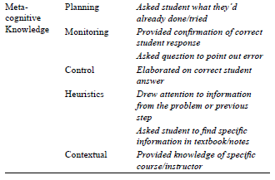

Slide 18
Tutors often ask students to carry out the steps of a process. They were not predominantly lecturing.

Slide 19
Tutors mostly determined the process needed to solve the problem

Slide 20
Tutors asked student to identify or recognize. Tutors would provide detailed explanations.

Slide 21
Tutors frequently re-worded a question without giving the student time to respond, often leaving them with a fill-in-the-blank question.

Slide 22
Metacognitive Knowledge
Tutors infrequently required students to utilize metacognitive knowledge.
Tutors mostly evaluated student work, though on some occasions they asked the student to evaluate their own work.
Tutors sometimes elaborated on student answers or asked follow-up questions.
Tutors sometimes asked a student to look up information in their notes/book.
Tutors often provided detailed explanations that linked mathematical ideas together.

Slide 23
Recommendations for Tutor Training
(1) Ask students to identify a solution path as well as the steps needed to carry out the problem.
(2) Allow the student to answer higher order questions without turning them into yes/no or multiple-choice type questions.
(3) After providing explanation, ask the student a question which requires the student to reason about the explanation provided rather than asking “right?”
(4) Explicitly model their own metacognitive processes and use questions to engage students in selecting and using metacognitive strategies. (i.e. ask student to read and break-down the problem statement)
(5) When a student’s utterance is incomplete or incorrect, ask the student a question to help them make their own mathematical realizations.

Slide 24
Follow-Up Study – 3-turn sequences

Slide 25
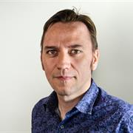
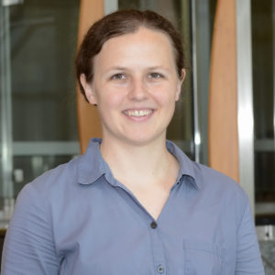
Meta-Analysis of Departmental Change Efforts
Anthony Cronin
University College Dublin
Deb Moore-Russo
University of Oklahoma
Katie Bjorkman
Richard Bland College

Slide 26
Background
National calls to push for more equitable and effective teaching practices in postsecondary mathematics (CBMS, 2016; MAA, 2018; NRC, 2013; Saxe & Braddy, 2015)
Calls for changes at the department level (Quan et al., 2019; Reinholz & Apkarian, 2018; Reinholz, Pilgrim, Corbo & Finkelstein, 2019)
Student Engagement in Mathematics through an Institutional Network for Active Learning (SEMINAL) Project (Smith, Voigt, Ström, Webb & Martin, 2021)

Slide 27
Organizational Change
Current models for organizational change in mathematics departments do not include the MLC as part of the equation!
Reinholz et al (2020) called for more MLC research as an example of organizational change

Slide 28
Characteristics of Successful Programs
Collection and use of local data
Effective placement system
Course coordination
Challenging course content
Student-centered instructional methods
GTA development program
Proactive student support services
(Bressoud et al., 2015; Bressoud & Rasmussen, 2015)

Slide 29
Research Questions
Where are change efforts focused when mathematics departments seek to increase student success in precalculus and calculus?
Are there germane aspects related to student success that are not reported or considered in change efforts?

Slide 30
Data Set
The 26 articles published in the 2021 Special Issue of PRIMUS on Insights and Lessons Learned from Mathematics Departments in the Process of Change (Volume 25, Issues 3-5)

Slide 31
Methods
Level | Description | Representative Examples
Level 0 | Characteristic not addressed in article
Level 1 | Characteristic mentioned as existing at institution but did not serve as part of current change effort OR | “...we already do some of these things quite effectively, notably items (2)–(4) and (7) [of the MAA Characteristics of Successful Calculus Programs].” (Bennoun & Holm, 2021, p. 568)
 | Characteristic mentioned as part of the change effort but details not addressed in article | “The following changes took place as part of this major change initiative [list of characteristics addressed in change effort] ... [In this paper] we discuss the successes and challenges that came with creating and implementing a new PD program for GTAs…” (Pilgrim et al., 2021, pp. 595-596)
Level 2 | Characteristic specifically addressed in article as part of change effort | “In this paper, we describe how we built on an existing community of practice around teaching to create an environment where active learning can flourish.” (Ksir et al., 2021, p. 459)

Slide 32
Results

Slide 33
Most Often Addressed Characteristics
Change efforts may begin with individual instructors and then are scaled up through course coordination
Driven by and focused on faculty
Often using terminology that is taken-as-shared, not always citing original sources or defining terms.

Slide 34
Results

Slide 35
Professional Development
Professional development (faculty or GTA) was addressed by six of the articles. Professional development included formal development opportunities, such as a seminar on teaching, or explicit instruction on a specific teaching technique.
Fourteen institutions reported having a community of practice for instructors where less-formal, or less prescribed, professional development took place, but these were not coded as professional development.

Slide 36
Professional Development
We recommend broadening the idea of professional development to include a greater range of those involved in students’ mathematical learning - not just tenure-track faculty, but VITAL faculty and others, such as tutors (e.g., see Cronin et al., 2016).

Slide 37
Results

Slide 38
Math Learning Centers
Only 3 of the 26 articles focused on student support services. In these papers, directors of the MLCs were part of the team.
MTC Directors can be part of the community of practice that is built around student-centered instruction.
MTCs can be a catalyst for changing culture, not just the culture of the faculty and administrators, but student culture as well

Slide 39
Math Learning Centers
Change efforts focused on student equity and paying attention to student thinking (e.g., Reinholz et al., 2019) should seek input in the ways and places they are most likely to give it, which research indicates may be an MLC rather than a classroom (Bjorkman, 2019; Solomon et al., 2010).

Slide 40
Math Learning Centers
MLCs have great potential to give feedback to instructors on such student thinking, including students’ common difficulties, that can in turn positively impact instruction (Cronin & Stewart, 2022; Cronin & Meehan, 2021; Cronin et al., 2019).
When mathematics instructors are changing pedagogies, tutoring centers should be part of the conversation so that they can also adapt their methods and provide feedback about students and their needs to instructors.

Slide 41
Thank you!

